Slide 1
WELCOME TO
SALES SKILLS MASTERCLASS
Please turn off your phones or put them on silent.
No flash photography during the sessions.
Please tag us on social
media using @Genistar

Slide 2
PLEASE WELCOME
SHARON WINT-GORDON
Executive Vice President
SALES SKILLS MASTERCLASS

Slide 3
OBJECTIVE OF THE DAY
Our aim is to guide you to become proficient with your communication skills required to professionally make phone calls and present the financial education, the financial plan and close Vitality premium with your clients.
We will also guide you to obtain 10-15 referrals from each client, as well as recruit people onto your team and open their warm markets.
SALES SKILLS MASTERCLASS

Slide 4
GROUND RULES
The workbook needs your continuous input and concentration for the next 8 hours.
We are filming, so write your questions & statements down. We will not pause for any questions so we can cut the videos efficiently.
SALES SKILLS MASTERCLASS

Slide 5
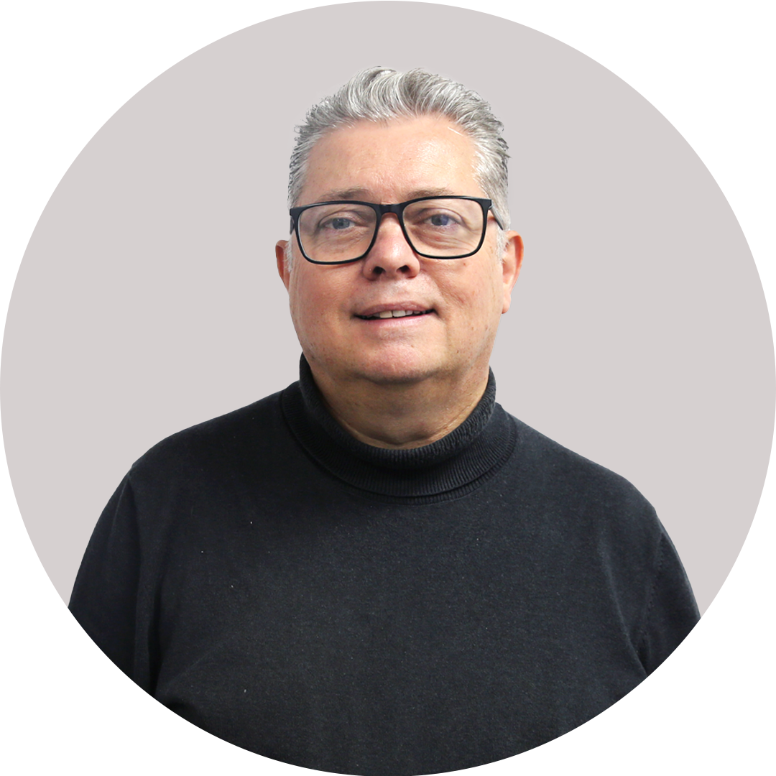
PLEASE WELCOME
STEVE JENKINS
Senior National Sales Director
SALES SKILLS MASTERCLASS

Slide 6
SESSION
GO FOR NO
Presented by Steve Jenkins
SALES SKILLS MASTERCLASS

Slide 7
GO FOR NO
Success
Me
Failure
SALES SKILLS MASTERCLASS

Slide 8
GO FOR NO
Me
Failure
Success
SALES SKILLS MASTERCLASS

Slide 9
Go For No
The Five Failure Levels
LEVEL 1
The Ability to Fail
SALES SKILLS MASTERCLASS

Slide 10
Go For No
The Five Failure Levels
LEVEL 2
The Willingness to Fail
SALES SKILLS MASTERCLASS

Slide 11
Go For No
The Five Failure Levels
LEVEL 3
The Wantingness to Fail
SALES SKILLS MASTERCLASS

Slide 12
Go For No
The Five Failure Levels
LEVEL 4
Failing BIGGER & Faster
SALES SKILLS MASTERCLASS

Slide 13
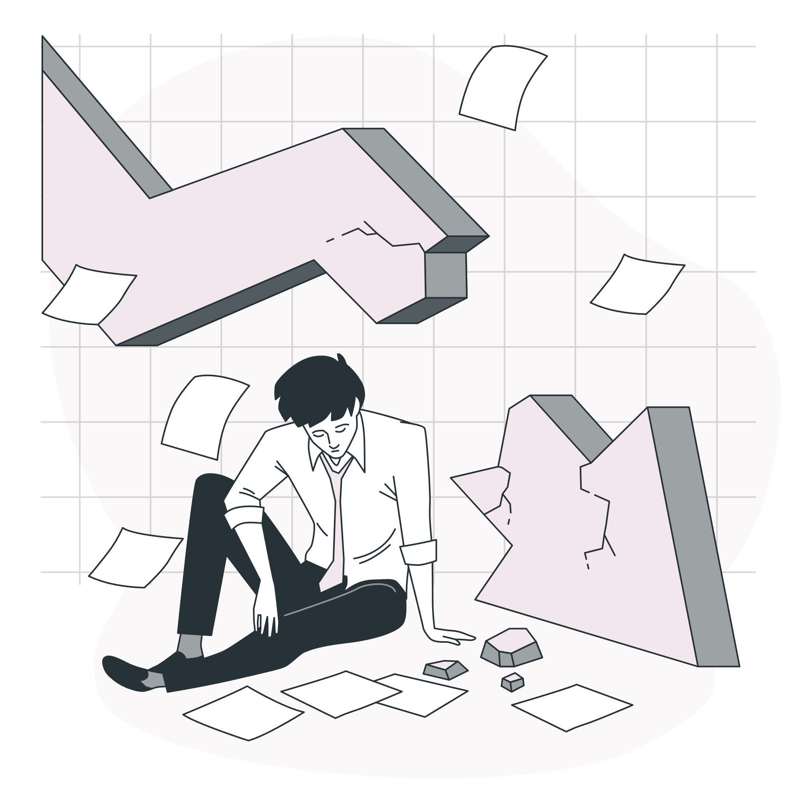
Go For No
The Five Failure Levels
LEVEL 5
Failing EXPONENTIALLY
SALES SKILLS MASTERCLASS

Slide 14
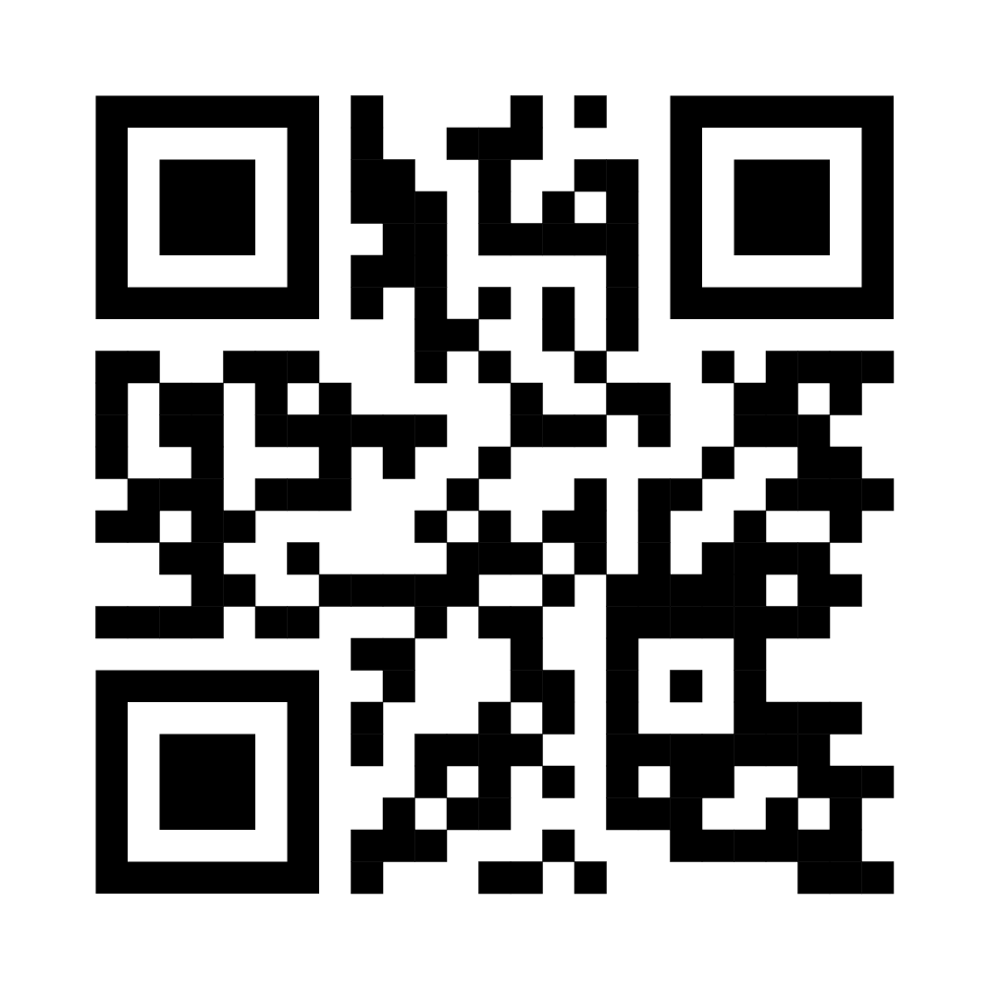
Scan this QR code to get your own copy of the ‘Go For No’ book.
SALES SKILLS MASTERCLASS

Slide 15
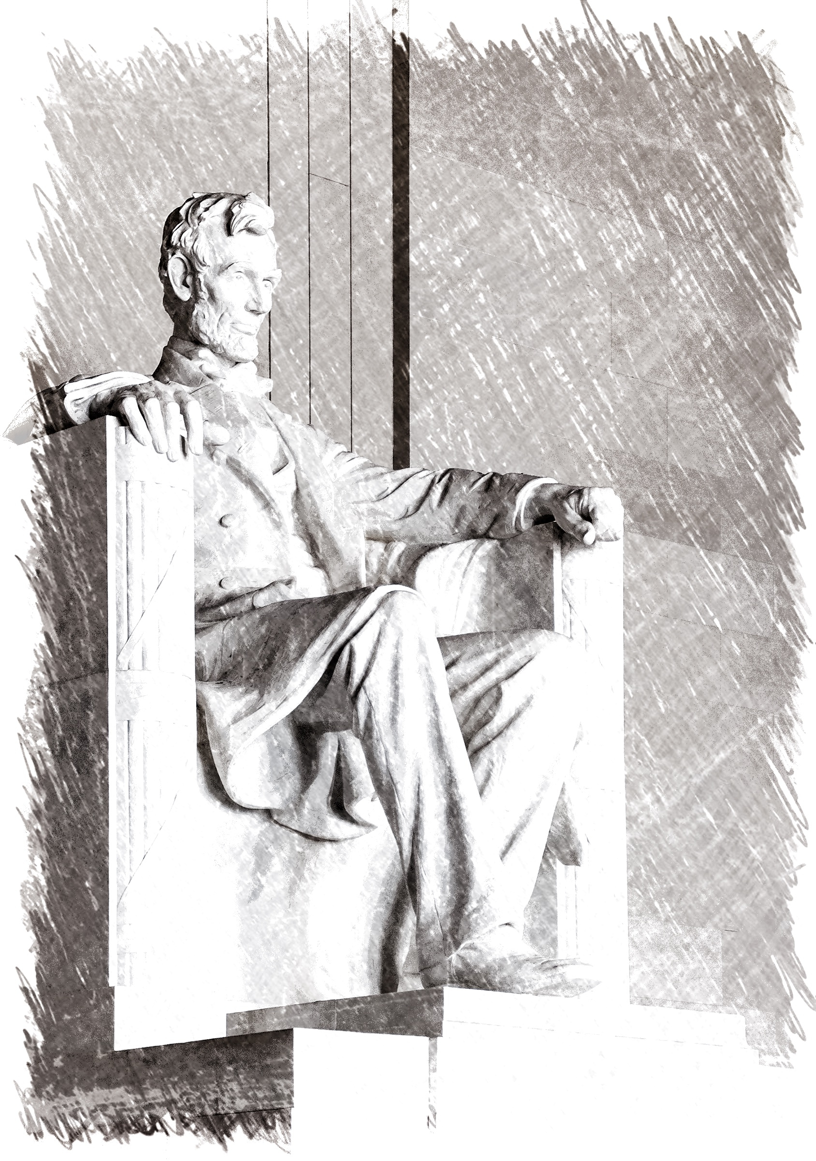
ABRAHAM LINCOLN
SALES SKILLS MASTERCLASS

Slide 16
You don’t want to buy
life insurance, do you?
SALES SKILLS MASTERCLASS

Slide 17
No Doesn’t Mean NEVER
RETRY
SALES SKILLS MASTERCLASS

Slide 18
Failing EXPONENTIALLY
SALES SKILLS MASTERCLASS

Slide 19
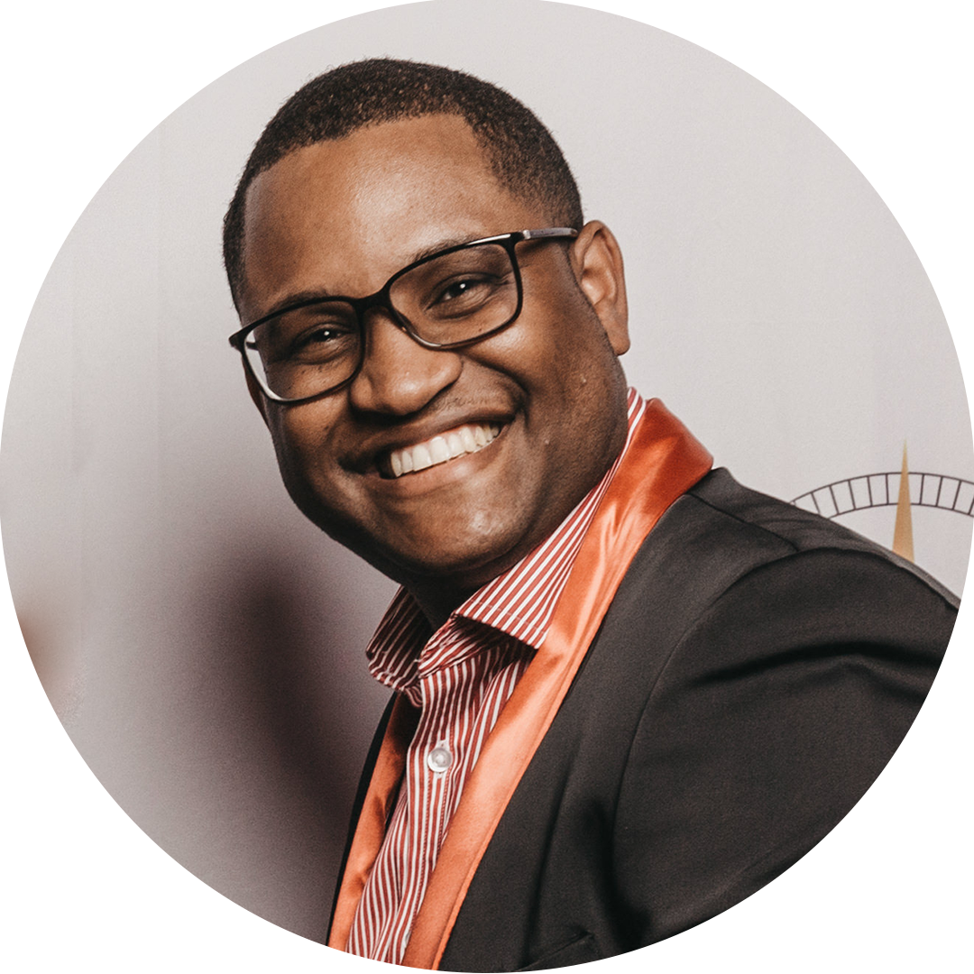
PLEASE WELCOME
BEVIN WINT
Senior Vice President
SALES SKILLS MASTERCLASS

Slide 20
S.I.G.N.
F.O.R.M. &
Presented by Bevin Wint
SALES SKILLS MASTERCLASS

Slide 21
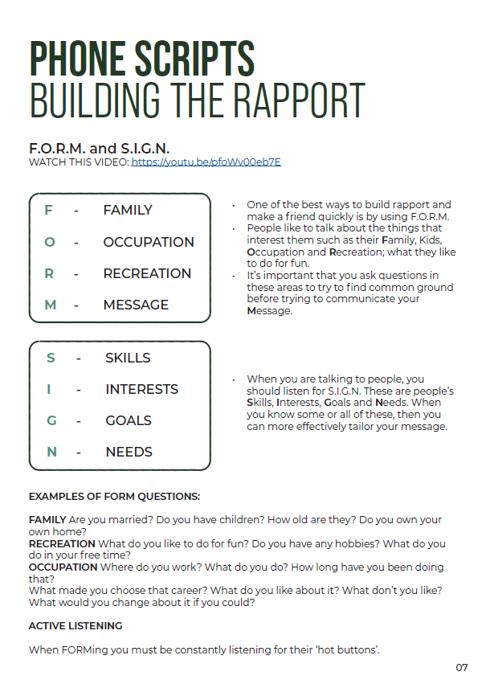
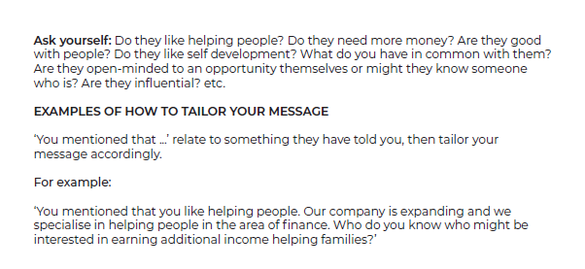
SALES SKILLS MASTERCLASS

Slide 22
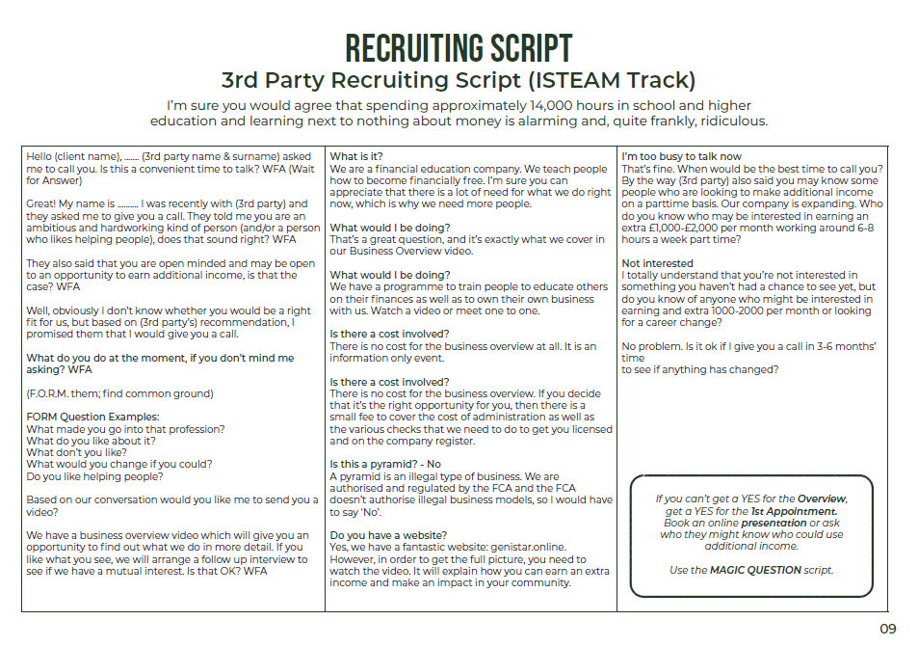
SALES SKILLS MASTERCLASS

Slide 23
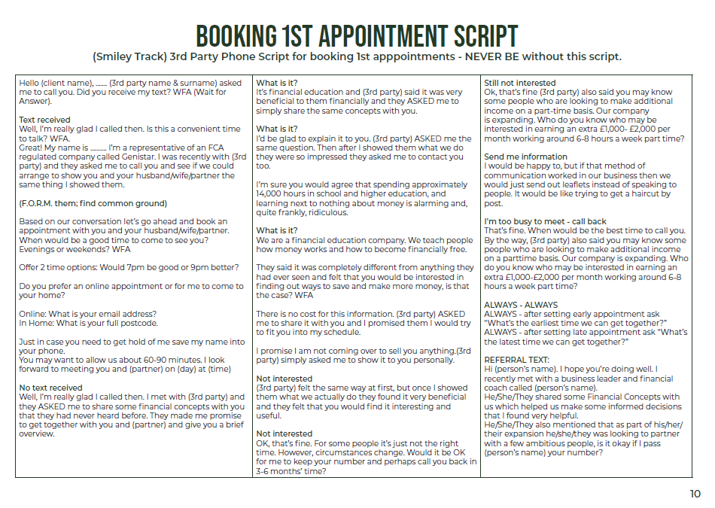
SALES SKILLS MASTERCLASS

Slide 24
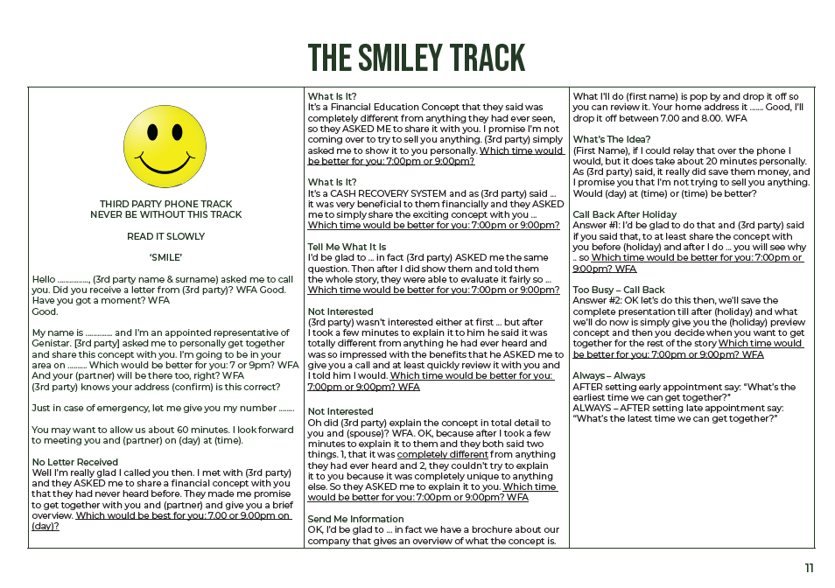
SALES SKILLS MASTERCLASS

Slide 25
HANDLING
OBJECTION
Presented by Bevin Wint
SALES SKILLS MASTERCLASS

Slide 26
OBJECTION HANDLING
List of Objections
I want to think about it.
I can’t afford the £99.
I don’t know a lot of people.
Not good at sales.
Too busy.
Pyramid scheme.
Too busy - no time.
I will discuss with my husband and come back to you.
I’m an introvert.
My job doesn’t let me do other work.
This income will affect my universal credit.
I need to pray about it.
The income will affect my maternity leave pay.
I don't like to join something that I have to pay money for.
I'm not good at speaking to other people.
I am already financially stable and don't need to do this.
Heard about Genistar before and I did not have a good experience.
I’ll just watch you & see if it works first.
My friends and family will be sceptical and won’t support me, so I won’t make any money.
Why should I pay £99 for referral when other companies just give a code to use.
In my Faith insurance is not permissible.
SALES SKILLS MASTERCLASS

Slide 27
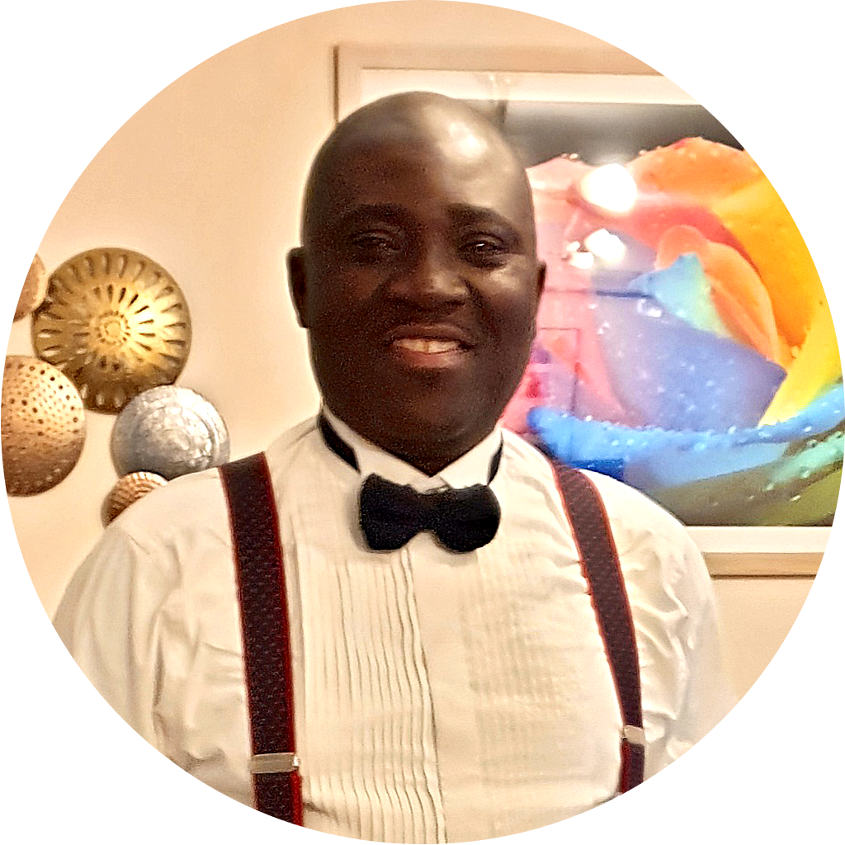
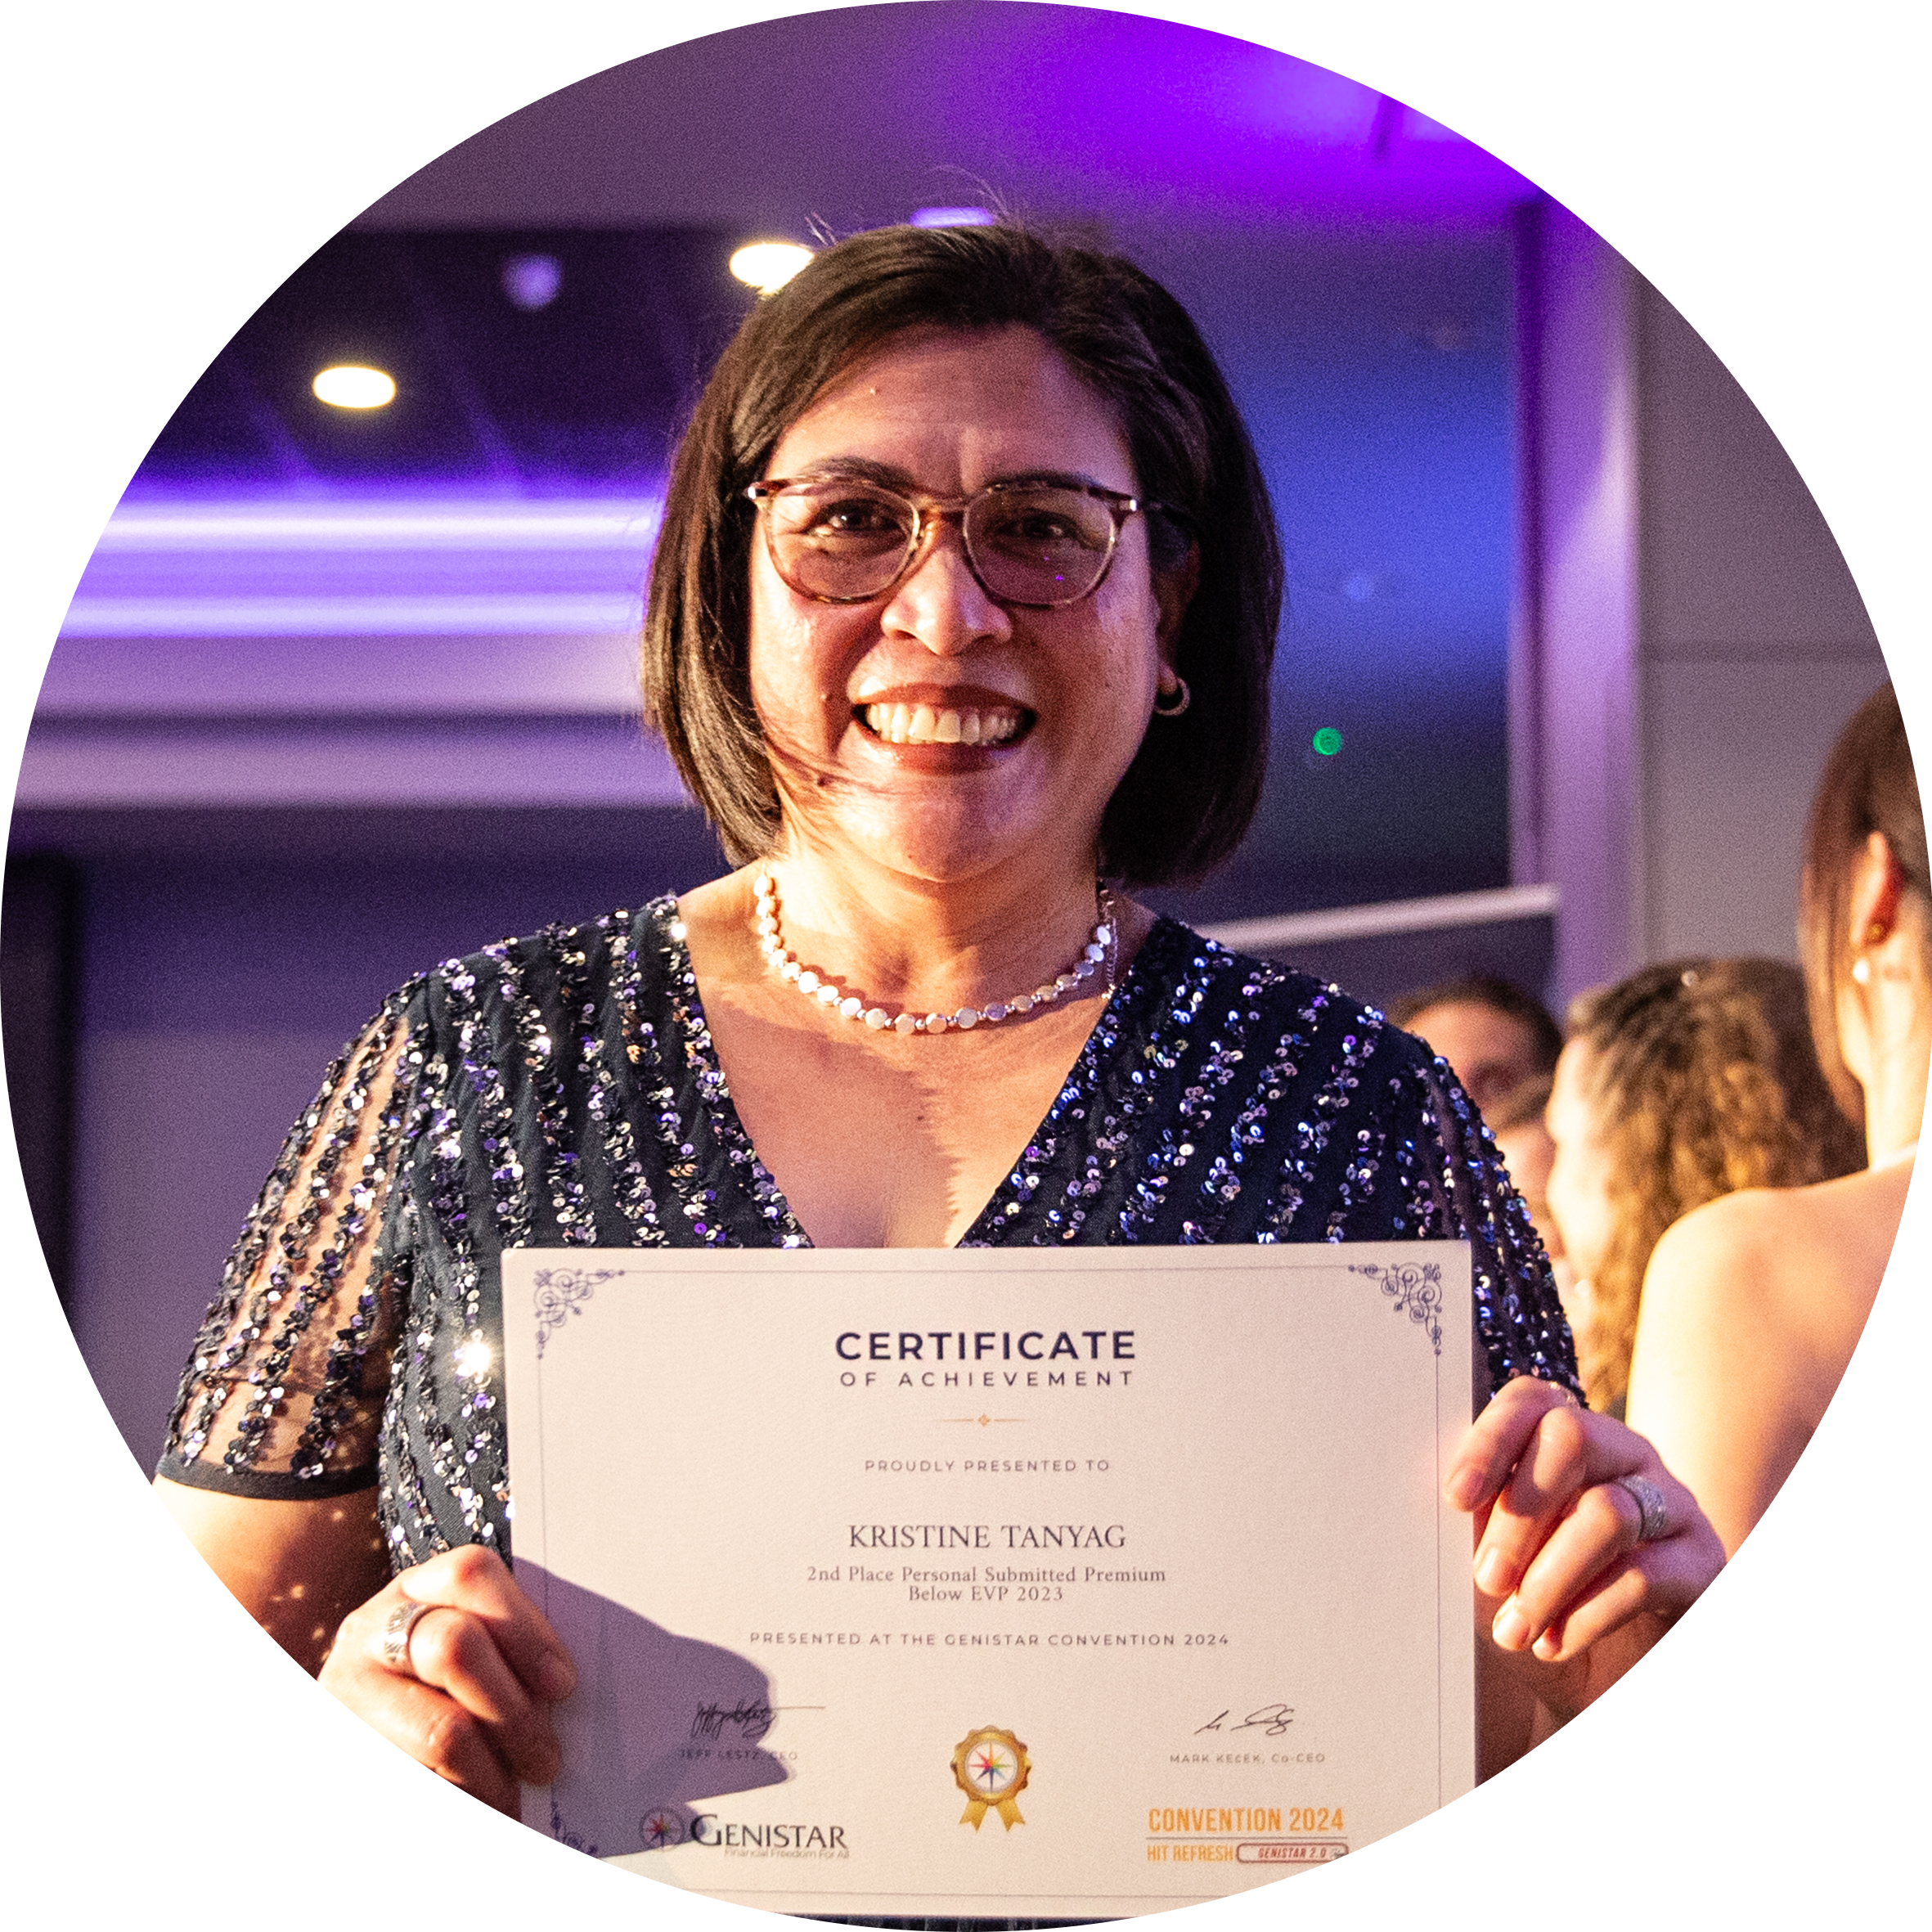
PANEL DISCUSSION
OBJECTION HANDLING
Hosted by Bevin Wint
Aitee Asemota
Gerry McGivern
Richard Nana Aykin
Kevin O’Malley
Kristine Tanyag
SALES SKILLS MASTERCLASS

Slide 28
SALES SKILLS MASTERCLASS
WE WILL BE BACK SHORTLY
Please turn off your phones or put them on silent.
No flash photography during the sessions.
Please tag us on social
media using @Genistar

Slide 29
WELCOME BACK TO
SALES SKILLS MASTERCLASS
Please turn off your phones or put them on silent.
No flash photography during the sessions.
Please tag us on social
media using @Genistar

Slide 30
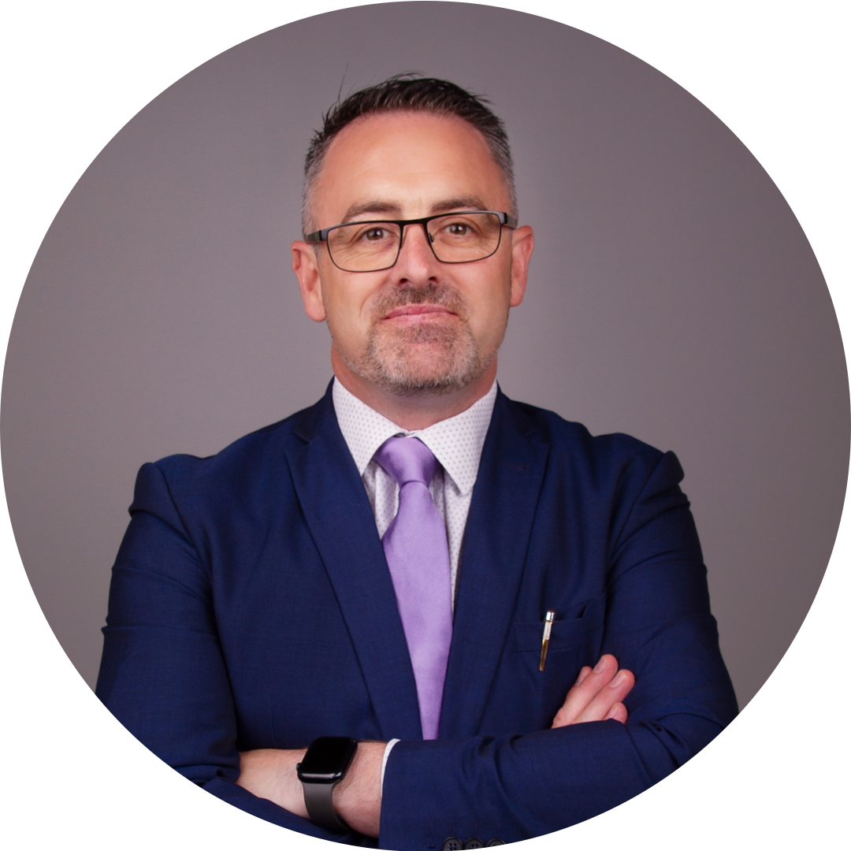
PLEASE WELCOME
ALAN PALMER
Senior Vice President
SALES SKILLS MASTERCLASS

Slide 31
FIND
FACT
Presented by Alan Palmer
SALES SKILLS MASTERCLASS

Slide 32
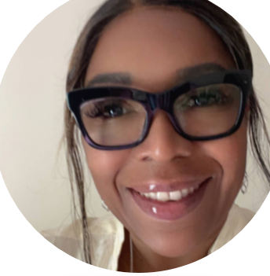
PLEASE WELCOME
BARBARA ANDERSON-STEWART
Senior Vice President
SALES SKILLS MASTERCLASS

Slide 33
NOTES
SOFT
Presented by Barbara Anderson-Stewart
SALES SKILLS MASTERCLASS

Slide 34
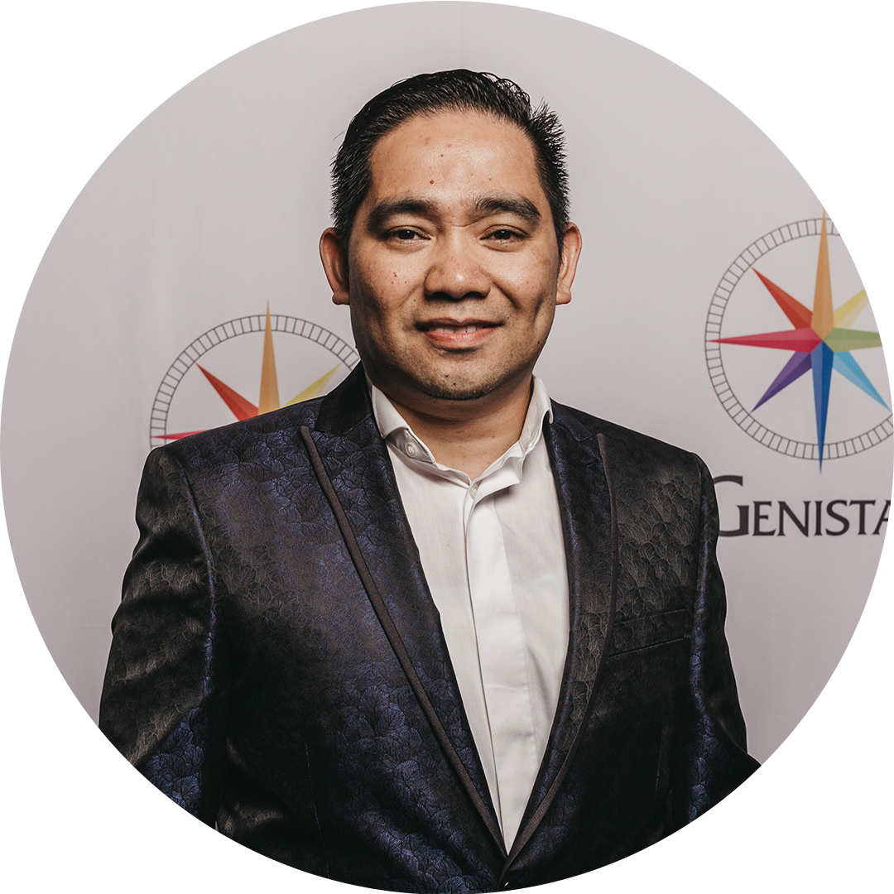
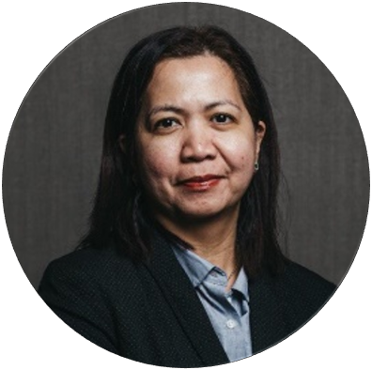
PLEASE WELCOME
ARVIN BURGOS
National Sales Director
DOLLY BRIGHT
Senior Vice President
SALES SKILLS MASTERCLASS

Slide 35
FINANCIAL PLAN
SELLING THE
Presented by Arvin Burgos and Dolly Bright
SALES SKILLS MASTERCLASS

Slide 36
RESOURCES
Grab a copy of our books from the Resource desk
Journey to Financial Freedom - £2
Jeff Lestz
True Riches by Jeff Lestz - £10
Jeff Lestz
Against All Odds by Jeff Lestz - £10
Jeff Lestz
Real Leadership - £15
John Addison
Genistar Notebooks - £10
Branded
SALES SKILLS MASTERCLASS

Slide 37
SALES SKILLS MASTERCLASS

Slide 38
HAVE LUNCH WITH SOMEONE
NEW TODAY!
SALES SKILLS MASTERCLASS

Slide 39
SALES SKILLS MASTERCLASS
WE WILL BE BACK SHORTLY
After lunch, please enter your respective breakout rooms for the afternoon sessions.
ROOM 1
New Genistar Members and REPs
ROOM 2
Team Leaders and Senior Team Leaders
ROOM 3
Group Leaders, Executive Vice Presidents & Above

