Slide 1

CLASS 6:
GETTING
STARTED
SALES PROCESS

Slide 2
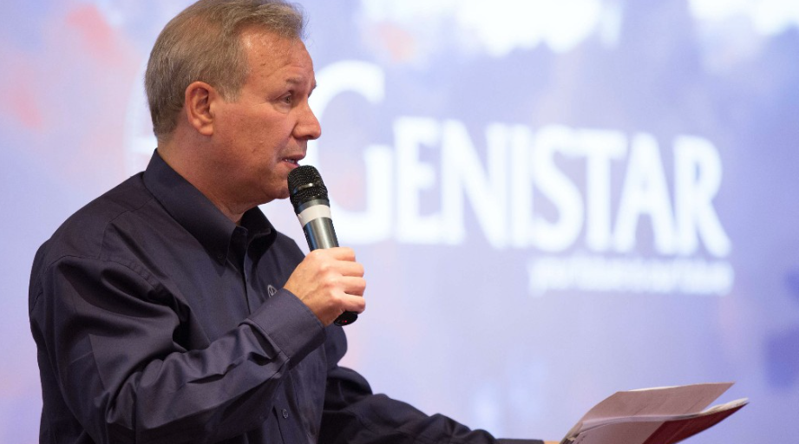

WELCOME TO
GENISTAR
Jeff Lestz Co-CEO

Slide 3
You joined us to build a business and make money right?
Not for a JOB and a boss…
WHY
GENISTAR?
why?

Slide 4

Spare, Part or Full-Time
Full Time (ish)
- Ready to make a career shift
EXECUTIVE VICE PRESIDENT (110%)
GROUP LEADER (70%)
Part Time
- 6-8 hrs/week
SENIOR TEAM LEADER (60%)
SPARE Time
- Whenever you’re free
TEAM LEADER (50%)
REPRESENTATIVE (25%)
how much time?

Slide 5
TEAM LEADER
IS THE TARGET
TL is the FIRST leadership position,
The FIRST supervision position…
TL is where your business BEGINS.
the target

Slide 6
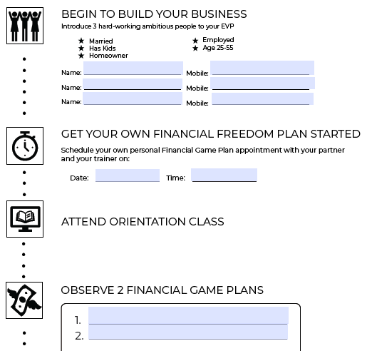
GET LICENCED
FIRST & FAST
Work with your trainer to complete your competency training…
This takes 2 weeks on average, can you do it in less?
competency

Slide 7




HOW DO YOU GET TO TL?
Firstly, get 3 new business partners
Then, write business with 3-4 clients
(must total £1,500 in annual premium)
breakdown

Slide 8

LET YOUR TRAINER HELP
We are invested in your success!
Your Trainer will work with you to teach how to help clients. Also, to recruit your team, while they do, you get PAID and closer to your Promotion.
breakdown

Slide 9
LET YOUR TRAINER HELP
What is i/k?
Your
INFLUENCE
i = Influence
k = Knowledge
You have the INFLUENCE, and your trainer has the KNOWLEDGE
Your
Trainer’s
KNOWLEDGE
breakdown

Slide 10
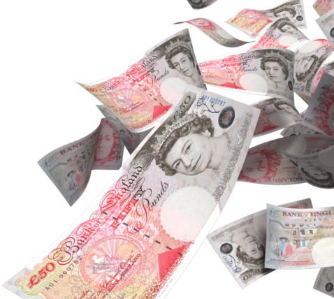
IS IT WORTH IT?
Would an extra £500 change anything in your budget?
how about…
£500 a month?
£500 a fortnight?
£500 a week?
CCMP

Slide 11
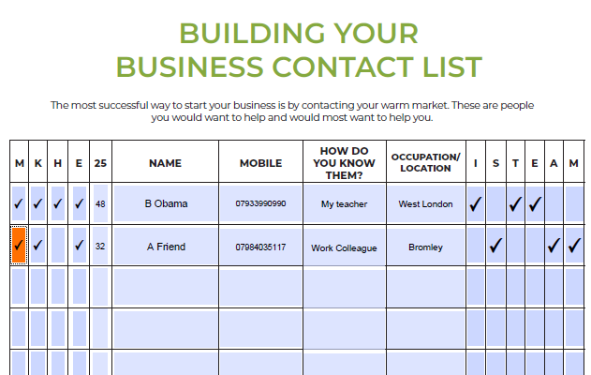

IT BEGINS WITH
2 LISTS
List one: Potential Business Partners
Influential
Sales
Teacher
Enthusiastic
Ambitious
has a Money goal
turn to pages 15 & 16 in your workbook

Slide 12
IT BEGINS WITH
2 LISTS
List two: Potential Clients
Married or a Couple
Children (kids)
Homeowner
Employed
Over 25
turn to pages 15 & 16 in your workbook

Slide 13
TALK TO YOUR TRAINER TODAY
Take your lists back to your trainer.
The best time to begin is today, and the sooner you get started the faster you get on track to meet your goals!
do it now

Slide 14

questions?

Slide 15

Thank You
SALES PROCESS

