Slide 1
Travel To
Rome

Slide 2
Rome with The Onsteads
What price would you pay to spend 3 days with the fastest rising person in Primerica?

Slide 3
The Onsteads have broken the base shop recruiting record:
702 recruits in one month
Submitting $535,000 premium in one month!
$0 to $1 million income in 5 years in the business.
Andy and Brittany want to spend time with our top people, and this is YOUR chance to: Hang out with the Onsteads and Jeff and Margo in Rome, one of the world's most incredible cities!

Slide 4
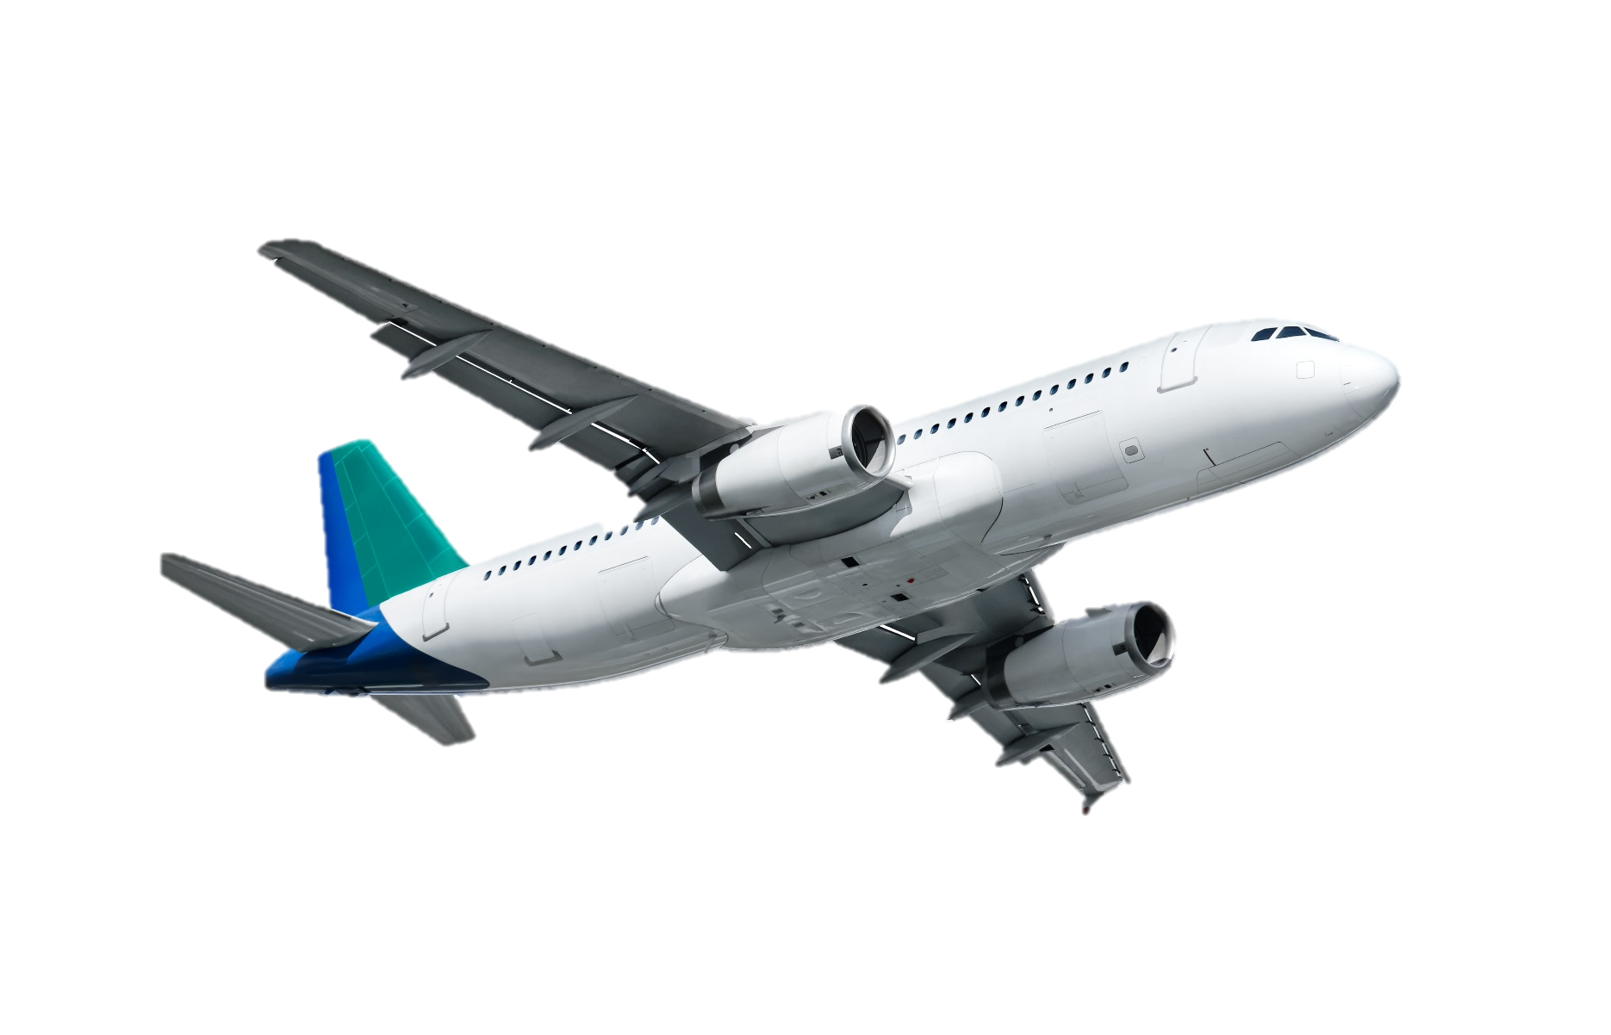
Qualify to win 3 days in Rome, Italy (16 -19 Feb) with Jeff & Margo Lestz and Andy and Brittany Onstead from Primerica.
Flights, Hotels and some meals are included.
If you want to join this special group, It’s up to you to go and do something special.

Slide 5
Qualifications
August – November 2024
50 Team IBAs x £50,000 APE Team Activated Business
Persistency including CFI must be above 90%
Max £1,000 to count per policy
No more than 50% from one leg
Contest is open to ALL LEVELS

