Slide 1
WELCOME TO
HOW TO BUILD A SUPER HIERARCHY
20th July 2024

Slide 2
GENERAL INFORMATION
Please put your phones on silent.
Where are the W/Cs?
Where are the emergency exits?
Please do not litter around the venue.
Make sure you
take notes.
HOW TO BUILD A SUPER HIERARCHY 2024

Slide 3
JEFF LESTZ
CEO, GENISTAR LTD
HOW TO BUILD A SUPER HIERARCHY 2024

Slide 4
How do we go from good to great?
Disciplined people, disciplined action, disciplined thought.
- Jim Collins, Good to Great
HOW TO BUILD A SUPER HIERARCHY 2024

Slide 5
HOW TO BUILD A SUPER HIERARCHY 2024

Slide 6
HOW TO BUILD A SUPER HIERARCHY 2024

Slide 7
HOW TO BUILD A SUPER HIERARCHY 2024

Slide 8
GENISTAR
Helping people secure a better financial future through:
FINANCIAL EDUCATION We empower people by educating them about how money works.
BUSINESS OPPORTUNITY We provide the opportunity ​to own your own business ​and control your own destiny.
FINANCIAL PLAN Our vision is to see societal change by helping millions of people secure a better future - one financial plan at a time​.
HOW TO BUILD A SUPER HIERARCHY 2024

Slide 9
The Leadership Pipeline Steps
Lead yourself
Lead others
Lead leaders
Lead an organisation
HOW TO BUILD A SUPER HIERARCHY 2024

Slide 10
EXECUTIVE VICE PRESIDENT (110%)
GENISTAR
JOURNEY
GROUP LEADER (70%)
SENIOR TEAM LEADER (60%)
REPRESENTATIVE
TO
EXECUTIVE VICE PRESIDENT
TEAM LEADER (50%)
REPRESENTATIVE (25%)
HOW TO BUILD A SUPER HIERARCHY 2024

Slide 11
LEADERSHIP PIPELINE
What do you need to change?
What will your schedule look like?
What's most valuable in your schedule?
What skills do you need to develop?
QUESTIONS
HOW TO BUILD A SUPER HIERARCHY 2024

Slide 12
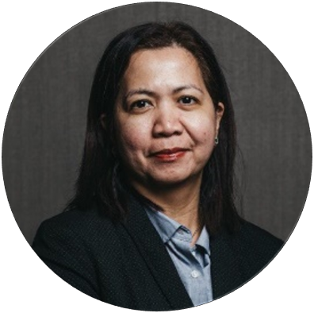
What Does a GOOD REPRESENTATIVE Look Like?
DOLLY BRIGHT, senior vice president
HOW TO BUILD A SUPER HIERARCHY 2024

Slide 13
What does a GOOD REPRESENTATIVE look like?
1. Lead yourself
You are the number one advertiser of your Genistar business
As a rep you need to have done your own FGP and be a client
2. Recruiting explosion
Recruit 1 person a week
Master the telephone call
Read chapter 1, the power of marketing
3. Get a license and learn the system
4. Lead others through promotion in motion
5. Take a leadership position
6. Always make money
HOW TO BUILD A SUPER HIERARCHY 2024

Slide 14
Transitioning from REP TO TEAM LEADER
BARBARA ANDERSON-STEWART, senior vice president
HOW TO BUILD A SUPER HIERARCHY 2024

Slide 15
THE CHANGES YOU MAKE
It’s about mindset shift
Stepping onto the rung of Leadership Ladder!
Balancing self & selflessness
Understanding what activities add value & what subtracts value
HOW TO BUILD A SUPER HIERARCHY 2024

Slide 16
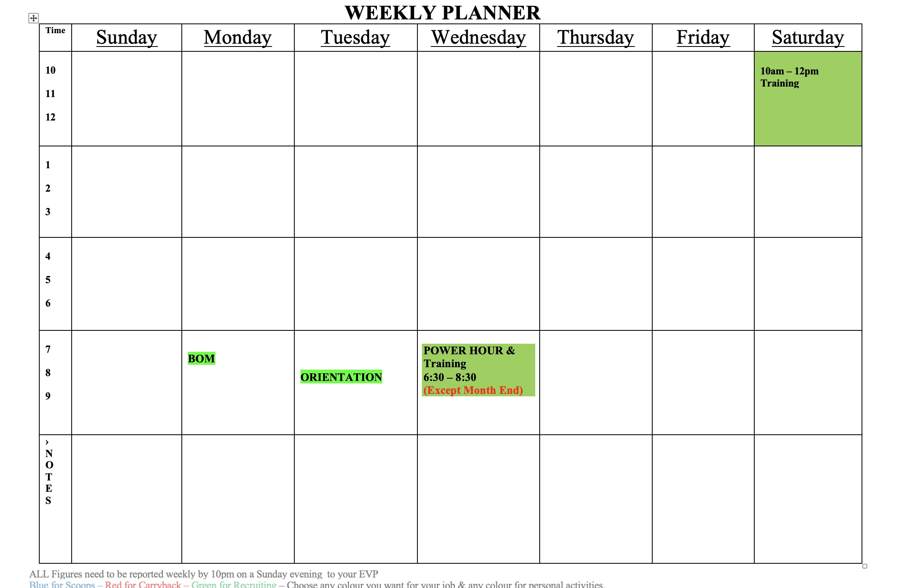
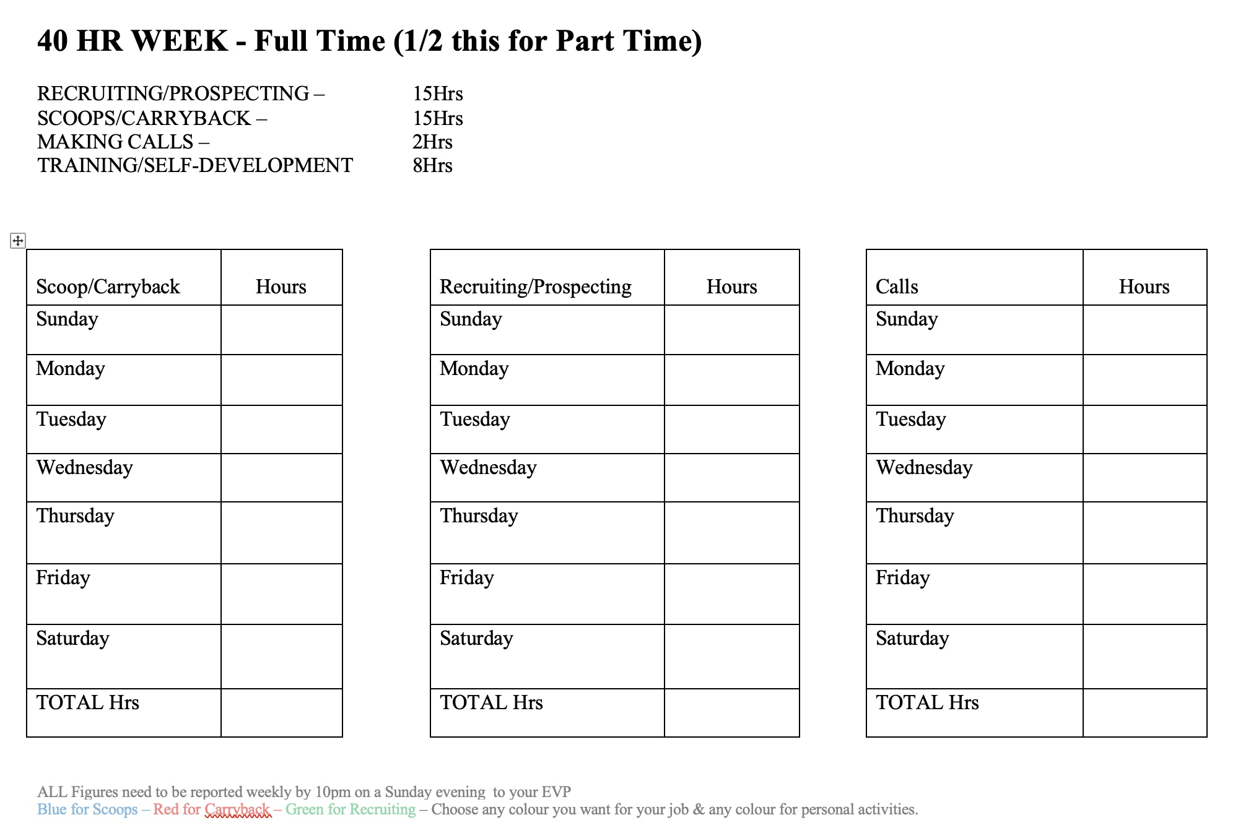
It starts with Your Weekly Planner
*** Doing half of 8 – 5 – 3 – 2 - 1
HOW TO BUILD A SUPER HIERARCHY 2024

Slide 17
SKILLS YOU DEVELOP
Become more inclusive
Learn to put ‘W’ in front of ‘E’ instead ‘M’ all the time
Marketing yourself & your business
HOW TO BUILD A SUPER HIERARCHY 2024

Slide 18
What do you value most in your schedule?
The power of using spare time to become an effective part-timer!
Read Chapter 2 – A builder's mindset
HOW TO BUILD A SUPER HIERARCHY 2024

Slide 19
TEAM LEADER
ALAN PALMER, senior vice president
HOW TO BUILD A SUPER HIERARCHY 2024

Slide 20
Understanding the Role of a Team Leader
Transitioned from running alone to overseeing and developing multiple teams.
Emphasize the importance of casting the vision.
Focus on building leadership capacity within the team.
HOW TO BUILD A SUPER HIERARCHY 2024

Slide 21
Your team is growing,
what next?
HOW TO BUILD A SUPER HIERARCHY 2024

Slide 22
Focus on building leadership capacity within the team.
Recruit personal and help your team to recruit and develop high-performing team leaders.
Foster a culture of collaboration, accountability, and continuous improvement.
Provide ongoing coaching and support to ensure team success – Saturday Training, Power Hours, Sunday Calls, Team Meetings and, of course, BIG EVENTS
Read chapter 7 - The Power of compound recruiting
HOW TO BUILD A SUPER HIERARCHY 2024

Slide 23
Delegation and Empowerment.
Trust team leaders to execute tasks while providing guidance and support to the team.
Empower leaders to make decisions and take ownership of their roles
A good Team Leader should have at least 6 Scoops in their diary and be aiming to get 3 yeses a day as a minimum
HOW TO BUILD A SUPER HIERARCHY 2024

Slide 24
Weekly Schedule of a Great Team Leader
– Evening routine
Power Hours 6pm-7pm
Scoops and Carrybacks with Clients, 1st two selling periods in your own market!
Ensure any new team members are on Orientation & Team Trainings
HOW TO BUILD A SUPER HIERARCHY 2024

Slide 25
Conclusion
The Team Leader role is the building block to help you achieve your goals of building a 6 and 7 figure income.
Continuous learning and development will take you to world class levels
Thank you everyone for your dedication and commitment to excellence, have a great day.
HOW TO BUILD A SUPER HIERARCHY 2024

Slide 26
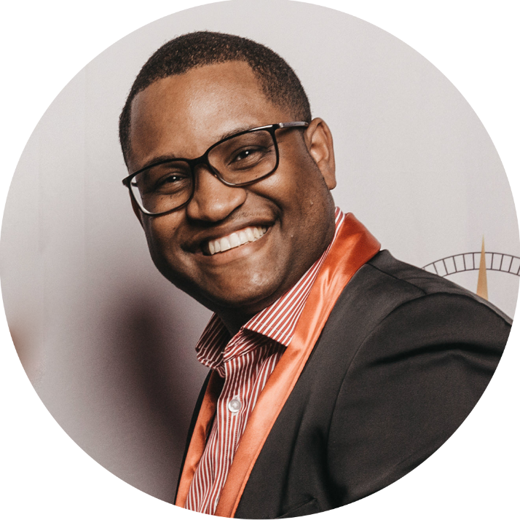
TEAM LEADER TO SENIOR TEAM LEADER
BEVIN WINT, senior vice president
HOW TO BUILD A SUPER HIERARCHY 2024

Slide 27
Qualifications
Produce two (2) team leaders direct to you.
Team submits over £3,900 in annualised premium in one month.
No more than 50% from one leg
90% persistency
HOW TO BUILD A SUPER HIERARCHY 2024

Slide 28
Mindset
Builder’s Mindset Philosophy:
Boutique vs chain of supermarket (distribution)
To achieve this new level, you are now required to balance personal and team activity, which is a mental paradigm shift!
Leadership responsibilities
Understand that the DEPTH Provides SECURITY:
This produces “Layers of Leaders” which will provide security in your income from over-ride commission
If you’re unable to work, having depth means you can still receive a good income because your income comes from a large group of people which insulates your income from adverse circumstances.
HOW TO BUILD A SUPER HIERARCHY 2024

Slide 29
Strategy
Focus on consistently recruiting 5 recruits per month as a minimum for your baseshop with the goal being 7 recruits per month
Build the team through ‘warm market’ referrals (easiest way)
Develop a 5-Star Market (qualify/upgrade referrals) - asking better questions
Travel double with new recruits (duplication)
HOW TO BUILD A SUPER HIERARCHY 2024

Slide 30
What Does a GOOD SENIOR TEAM LEADER Look Like?
STEVE JENKINS, senior NATIONAL SALES DIRECTOR
HOW TO BUILD A SUPER HIERARCHY 2024

Slide 31
What Does a GOOD SENIOR TEAM LEADER Look Like?
Has clearly defined goals (CCMP)
Has clearly defined income goal
Has dedicated prime client times
Attends regular training
HOW TO BUILD A SUPER HIERARCHY 2024

Slide 32
Skills obtained
Learnt how to develop Team Leaders
Is a good Field Trainer
Travels double 100% of the time
Has 100 + referrals
Gets into the Comma Club
HOW TO BUILD A SUPER HIERARCHY 2024

Slide 33
Transitioning from SENIOR TEAM LEADER TO GROUP LEADER
HOW TO BUILD A SUPER HIERARCHY 2024

Slide 34
What needs to change?
What will your schedule look like?
What's most valuable in your schedule?
What skills do you need to develop?
HOW TO BUILD A SUPER HIERARCHY 2024

Slide 35
Becoming a STL is a significant Milestone because………..
In transition from STL to GL, there are changes
Feeling you have to do it again
Keep recruiting and it will happen automatically
Changing from spare time to consistent part time developing a rhythm
1st step changing from a player to a coach player/coach
HOW TO BUILD A SUPER HIERARCHY 2024

Slide 36
Manage your Time
Structure needs to take place
e.g., Power Hours, training attendance to create a rhythm
Collaborating with other leaders
Start to organise admin, pipeline etc.
If desirable, start a plan for full time EVP
Invest in your own professional development
Start discussing accountability with your EVP
Be open to feedback and coaching
Allocate dedicated time for personal and family commitments
HOW TO BUILD A SUPER HIERARCHY 2024

Slide 37
Skills to Develop
Master the third-party referral system
Master scoop, carryback, folllow up interview
Start adopting the Perfection checklists
Study leadership development – speak publicly at every opportunity
Learn everything from a point of teaching it
Relationship Building: Cultivate relationships to foster collaboration,
share best practices, and build a strong support network
HOW TO BUILD A SUPER HIERARCHY 2024

Slide 38
Conclusion
Transitioning from a STL to a GL is an exciting and challenging journey.
Embrace the changes, adjust your schedule, and focus on developing the essential skills required for success.
Remember, this transition is not just about personal growth; it's about positively impacting the lives of your team members and indirectly changing 1000s of clients lives and helping Genistar become a household name.
Study Chapter 6 Tap Rooting in How to Build a Super Hierarchy
HOW TO BUILD A SUPER HIERARCHY 2024

Slide 39
What Does a GOOD GROUP LEADER Look Like?
DOLLY BRIGHT, senior vice president
HOW TO BUILD A SUPER HIERARCHY 2024

Slide 40
HAVING AN EVP MINDSET
Building a Baseshop
Setting an example
Producing results
Read chapter 5 – Speed Width
‘If you want to be an EVP, then act like an EVP.’
- Art Williams
HOW TO BUILD A SUPER HIERARCHY 2024

Slide 41
PROMOTIONS IN MOTION
3 team leaders a month
Group leader factory
Duplication happens
HOW TO BUILD A SUPER HIERARCHY 2024

Slide 42
BUILD LIKE AN EVP
Develop independent leaders
Develop a field trainer
Understand the management exchange
Master the double O’s
HOW TO BUILD A SUPER HIERARCHY 2024

Slide 43
Transitioning from GROUP LEADER TO EVP
BARBARA ANDERSON-STEWART, senior vice president
HOW TO BUILD A SUPER HIERARCHY 2024

Slide 44
THE CHANGES YOU MAKE
It’s about mindset shift
Stepping into full time leadership
The power of the ‘You’ attraction
Staying level-headed in crisis & turmoil
Become more decisive
Be the right person in the right place at the right time (or not)
Stay respectful of the home you are stepping out of
HOW TO BUILD A SUPER HIERARCHY 2024

Slide 45
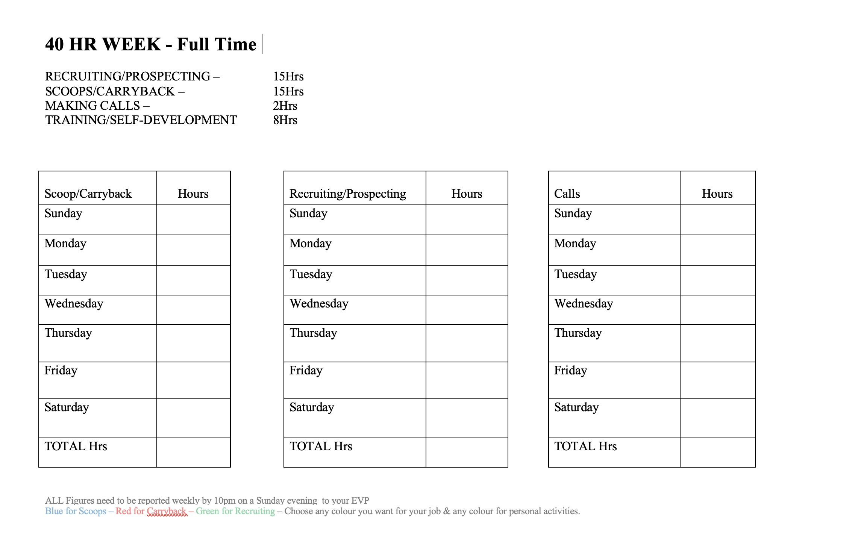
It starts with Your Weekly Planner
***8 – 5 – 3 – 2 - 1
HOW TO BUILD A SUPER HIERARCHY 2024

Slide 46
(Accountability)
Takes ownership of team outcomes, both successes and failures.
Holds themselves and the team accountable for results.
Maintains open and honest communication.
Builds trust through consistent and transparent actions.
HOW TO BUILD A SUPER HIERARCHY 2024

Slide 47
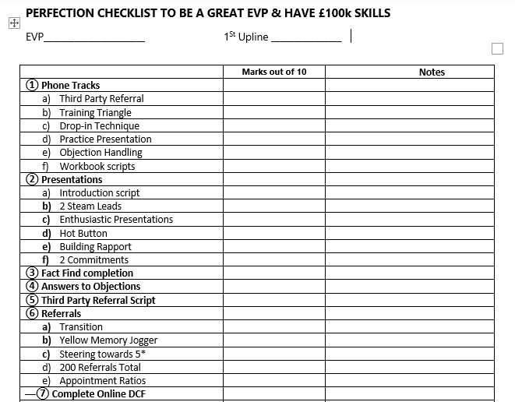
Having a perfection checklist
HOW TO BUILD A SUPER HIERARCHY 2024

Slide 48
SKILLS YOU DEVELOP
Delegation
Time Management
Listening
Hearing what is not being said
Read chapter 11– Compress activities and collapse time frames
HOW TO BUILD A SUPER HIERARCHY 2024

Slide 49
What do you value most in your schedule?
Control and Freedom
HOW TO BUILD A SUPER HIERARCHY 2024

Slide 50
What Does a GOOD EXECUTIVE VICE PRESIDENT Look Like?
Alan palmer, senior vice president
HOW TO BUILD A SUPER HIERARCHY 2024

Slide 51
You need to be able to sell the dream to the team!
We need to build a team of people who want their dreams to come through and you need to train them to build their own team of dreamers
HOW TO BUILD A SUPER HIERARCHY 2024

Slide 52
Qualities and Skills of an Effective EVP
(Personal Qualities)
INTEGRITY
Demonstrates honesty and strong moral principles.
Consistently does what is right, even when it’s difficult.
HOW TO BUILD A SUPER HIERARCHY 2024

Slide 53
EMPATHY
Understands and shares the feelings of others.
Shows genuine concern for team members’ well-being
HOW TO BUILD A SUPER HIERARCHY 2024

Slide 54
CONFIDENCE
Displays self-assurance and decisiveness.
Inspires trust and respect through a calm and composed demeanour.
HOW TO BUILD A SUPER HIERARCHY 2024

Slide 55
Communication Skills
CLARITY
Communicates goals, expectations, and feedback clearly
and concisely.
Ensures everyone understands their roles and responsibilities.
HOW TO BUILD A SUPER HIERARCHY 2024

Slide 56
ACTIVE LISTENING
Pays full attention to team members’ inputs and concerns.
Encourages open dialogue and values others' perspectives.
HOW TO BUILD A SUPER HIERARCHY 2024

Slide 57
PERSUASION
Effectively influences and motivates others to achieve common goals.
Uses compelling arguments and positive reinforcement.
HOW TO BUILD A SUPER HIERARCHY 2024

Slide 58
STRATEGIC VISION
(Forward Thinking)
Anticipate future trends and challenges
Develop long-term plans and strategies
Sets clear, achievable objectives and goals
HOW TO BUILD A SUPER HIERARCHY 2024

Slide 59
Make 2hrs of calls every day
8-5-3-2-1 every week
Work Hard,
Work Smart,
But Not Forever!
- Alan Palmer
Daily catch ups with your leaders
Team training
Attend all company events
Chapter 10 - A system where building never stops
HOW TO BUILD A SUPER HIERARCHY 2024

Slide 60
CONCLUSION
Lead by example and set a positive tone, Inspire others to strive for excellence and pursue common goals.
By embodying these qualities and skills, an EVP can effectively inspire and guide their team, fostering an environment of trust, collaboration, and high performance!
HOW TO BUILD A SUPER HIERARCHY 2024

Slide 61
Transitioning from EVP to SENIOR VICE PRESIDENT
STEVE JENKINS, senior NATIONAL SALES DIRECTOR
HOW TO BUILD A SUPER HIERARCHY 2024

Slide 62
What needs to change?
What will your schedule look like?
What's most valuable in your schedule?
What skills do you need to develop?
HOW TO BUILD A SUPER HIERARCHY 2024

Slide 63
Becoming an EVP is a significant milestone because
In transition from EVP to SVP, there are changes
Change from working with everybody to working with the workers
How do you identify the EVP candidate
Developing structure for your team to follow
Use the Perfection Checklists to get your EVP candidates ready
HOW TO BUILD A SUPER HIERARCHY 2024

Slide 64
Manage your Time
Structure needs to be on your time not their’s
Your rhythm needs to be consistent
Collaborating with other leaders
Your Administrator runs your business so you can expand your business
Help your Candidates go Full time
Study read and learn Leadership
Start Accountability with your EVP Candidates
Have a regular meeting with them
Allocate dedicated time for personal and family commitments
HOW TO BUILD A SUPER HIERARCHY 2024

Slide 65
Skills to Develop
Observe, coach and improve their presentations
Retrain them in the field
Put them in public speaking spots at every opportunity
Teach them to learn everything from a point of teaching it
Help them to foster collaboration, share best practices, and build a strong support network
HOW TO BUILD A SUPER HIERARCHY 2024

Slide 66
Conclusion
Transitioning from EVP to SVP is an exciting and challenging journey
Embrace the changes, adjust your schedule, and focus on developing the essential skills required for success
Remember, this transition is not just about personal growth; it's about positively impacting the lives of your team members and indirectly changing 10,000s of clients lives and helping Genistar become a household name
Study Chapter 12 – Profile of the great hierarchies (THE MASTER BUILDERS)
HOW TO BUILD A SUPER HIERARCHY 2024

Slide 67
What Does a GOOD SENIOR VICE PRESIDENT Look Like?
BEVIN WINT, senior vice president
HOW TO BUILD A SUPER HIERARCHY 2024

Slide 68
Qualifications
3 first generation EVPs direct to you
35 recruits x £35,000 of submitted premium from you and entire 1st Generation Hierarchy (after the 3rd EVP has been promoted)
Minimum of 10 recruits x £10,000 annual premium submitted from EVP’s Baseshop
90% persistency
HOW TO BUILD A SUPER HIERARCHY 2024

Slide 69
Mindset
Builders Mindset Philosophy: Chapter 2 of the secrets of a building a super hierarchy
Study the section on Being a Master Builder: Difference between being a Carpenter vs Contractor
Constantly and Consistently developing your Leadership Mindset: Responsibility to your baseshop, hierarchy and company
Delegation (PA, other leaders, the company etc): being able to trust others to help you grow your business
HOW TO BUILD A SUPER HIERARCHY 2024

Slide 70
Strategy
Focus on consistently adding 17 recruits per month as a minimum for your baseshop with the goal being 30 recruits per month!
Identifying potential EVP candidates by evaluating their Commitment and Coachability:
How they manage Group Movement i.e. social media groups, championing leaderboards, yeses board etc.
The 1st to turn up/book events and the last to leave events, training etc and they galvanise and encourages others to do the same.
Producing progressively consistent results by demonstrating Team Player Qualities i.e. helping others in the team with licencing, making phone calls, completing applications etc. Must have hunger and work ethic to achieve their personal targets.
Have a Duplicatable System that others can easily follow (Turn-Key Process) do not make the business look difficult. NO one will follow IF YOU DO!!
MASTER the Management Exchange Process-This will Collapse timeframes in producing new EVPs.
HOW TO BUILD A SUPER HIERARCHY 2024

Slide 71
AWARD RULES
Certificates: If the person being awarded a certificate is not present, the EVP should come up and receive the certificate for them.
Pins: Pins are only for those who are present. You may NOT collect a pin for someone who is not here.
HOW TO BUILD A SUPER HIERARCHY 2024

Slide 72
2nd quarter PROMOTIONS
HOW TO BUILD A SUPER HIERARCHY 2024

Slide 73
Team leader promotions
2nd quarter 2024
REP NAME
UPLINE EVP
Regina Bulaong | Arvin & Genevieve Burgos
Ogbonnia Okolo | Justina And Christopher Ilochi
Jitbahadur Pun | Bharatmani Chongbang Limbu
Timilehin Olatunde | Justina And Christopher Ilochi
Nathalie Asse Nee Kouassi-Zessia | Aitee Asemota
Olakemi Habibat Ogunmefun | Joyce Agbor
Princess Landu Manangu | Joyce Agbor
Amara Lynda Chikpezie Ikenwankwo | Joyce Agbor
Offiong Dan | Bevin Wint
Evangelino Cervas | Roger Munar
Hyacinth Sweeney Dixon | Stephanie Stewart
Abdurahman Jannuni Abduraja | Dolly & William Bright
Wilson Leones | Arvin & Genevieve Burgos
Przemyslaw Szoka | Arvin & Genevieve Burgos
Edmund Browne | Bevin Wint
Mercy Peprah | Betty Hammond
HOW TO BUILD A SUPER HIERARCHY 2024

Slide 74
Team leader promotions
2nd quarter 2024
REP NAME
UPLINE EVP
Damir Romanotto | Alan & Andrea Palmer
Claudia Vatomene Tomas | Samuel & Gilda Leigh
Lenny Abasolo | Dolly & William Bright
Obianuju Onunne Okaforudeji | Steven Jenkins
Oke Idiegbe | Christiane Metoukson Dawe
Killian Chukwuetoo Enujuba | Justina And Christopher Ilochi
Asmat Shaikh | Rafiq Mz
Sylvia Peters | Alan & Andrea Palmer
Diana Kunda | Christiane Metoukson Dawe
Patricia Harrison | Barbara Anderson-Stewart & Linton Stewart
Doreen Wray-Niles | Barbara Anderson-Stewart & Linton Stewart
Kiran Kumar Limbu | Bharatmani Chongbang Limbu
Maria Lorena Lucas Mitte | Christiane Metoukson Dawe
Josephine Lumabas | Ruvena Longno
Stefani Pamela Gomez Lucas | Christiane Metoukson Dawe
Martine Carole Mebeyo'o | Christiane Metoukson Dawe
HOW TO BUILD A SUPER HIERARCHY 2024

Slide 75
Team leader promotions
2nd quarter 2024
REP NAME
UPLINE EVP
Fjlyn Obias Cayabyab | Mel & Fred Berganio
Farouq Adeshina | Olayinka Cline-Thomas
Ronn Faller | Roger & Leilani Palima
Irish Kate Balai | Roger & Leilani Palima
Keisha Adair Swaby | Sharon Wint-Gordon
Doris Nwokedi | Joyce Agbor
Simon Farmer | Henry & Marivic Jubilan
Neil Somerville | Sharon Wint-Gordon
Lilian Eze | Aitee Asemota
Didier Kindembe | Joyce Agbor
Shirley Quinto Flores | Arvin & Genevieve Burgos
Myla Angeles | Dolly & William Bright
HOW TO BUILD A SUPER HIERARCHY 2024

Slide 76
Team leader promotions
2nd quarter 2024
REP NAME
UPLINE EVP
Milrose De Leon | Arvin & Genevieve Burgos
Antoinette Abena Agyarko | Samuel & Gilda Leigh
Chantelle Gardner | Barbara Anderson-Stewart & Linton Stewart
Prisca Onyeahialam | Joyce Agbor
Kiestiane Wright | Henry & Marivic Jubilan
Ma Eloisa Nitura | Roger Munar
Raquel Piedad Carrillo Hernandez | Christiane Metoukson Dawe
Gbenga Fanikasi | Justina And Christopher Ilochi
Odigie Humphrey Iyoha | Justina And Christopher Ilochi
HOW TO BUILD A SUPER HIERARCHY 2024

Slide 77
Senior Team leader promotions
2nd quarter 2024
REP NAME | UPLINE EVP
Jesica Jacqueline Lucas Mitte | Christiane Metoukson Dawe
Brenda Lawrence | Steven Jenkins
Esther Ebubechi Alobu | Joyce Agbor
Vida Fatima Szoka | Arvin & Genevieve Burgos
Noli Panal | Marilou Canoy and Alec De Leon
Ogbonnia Okolo | Justina And Christopher Ilochi
Timilehin Olatunde | Justina And Christopher Ilochi
HOW TO BUILD A SUPER HIERARCHY 2024

Slide 78
Group leader promotions
2nd quarter 2024
REP NAME | UPLINE EVP
Vida Fatima Szoka | Arvin & Genevieve Burgos
Sherell Metoukson | Christiane Metoukson Dawe
Juliet James-Lionel | Barbara Anderson-Stewart & Linton Stewart
HOW TO BUILD A SUPER HIERARCHY 2024

Slide 79
2nd quarter recognition
HOW TO BUILD A SUPER HIERARCHY 2024

Slide 80
GO-GETTERS
Qualifications:
Personally produce 3 recruits and £3,000 submitted Vitality premium in the same business month
EVPs may also achieve Go-Getter status by helping 3 team members achieve Go-Getter in one business month
A maximum of £1,000 APE counts per policy for this award
A recruit does not count if their IBA is refunded
HOW TO BUILD A SUPER HIERARCHY 2024

Slide 81
GO-GETTERS April 2024
BELOW EVP
NAME | UPLINE EVP
Evelyn Cunanan (GL) | Dolly & William Bright
Kristine Tanyag (GL) | Dolly & William Bright
Vida Fatima Szoka (GL) | Arvin & Genevieve Burgos
EVP & ABOVE
Alan & Andrea Palmer
Arvin & Genevieve Burgos
Barbara Anderson-Stewart & Linton Stewart
Jocelyn & John Lantron
Kevin O'Malley
Roger & Leilani Palima
Steve Jenkins
HOW TO BUILD A SUPER HIERARCHY 2024

Slide 82
GO-GETTERS may 2024
BELOW EVP
NAME | UPLINE EVP
Josephine Lumabas | Ruvena Longno
Milrose De Leon | Bevin Wint
Rose Okechi-Mbalaso | Daryl Harper
Vida Fatima Szoka | Arvin & Genevieve Burgos
Winifred Osakwe | Bevin Wint
EVP & ABOVE
Alan & Andrea Palmer
Arvin & Genevieve Burgos
Joyce Agbor
Kevin O'Malley
Olayinka Cline-Thomas
Sharon Wint-Gordon
Sol Colarina
HOW TO BUILD A SUPER HIERARCHY 2024

Slide 83
GO-GETTERS june 2024
BELOW EVP
NAME | UPLINE EVP
Simon Farmer | Henry & Marivic Jubilan
Esther Ebubechi Alobu | Joyce Agbor
EVP & ABOVE
Daryl Harper
Roger & Leilani Palima
HOW TO BUILD A SUPER HIERARCHY 2024

Slide 84
SPRINT AWARD
Qualifications:
Get to Team Leader within 30 days of​ your IBA being approved
HOW TO BUILD A SUPER HIERARCHY 2024

Slide 85
Sprint award winner
Name | Number of Days | EVP Upline
Wilson Leones | 16 | Arvin and Genevieve Burgos
HOW TO BUILD A SUPER HIERARCHY 2024

Slide 86
TEAM RECRUITMENT
2ND QUARTER 2024
HOW TO BUILD A SUPER HIERARCHY 2024

Slide 87
TEAM RECRUITMENT
No.1
EVP AND ABOVE
1ST PLACE
STEVE JENKINS
56 RECRUITS
2ND QUARTER 2024
HOW TO BUILD A SUPER HIERARCHY 2024

Slide 88
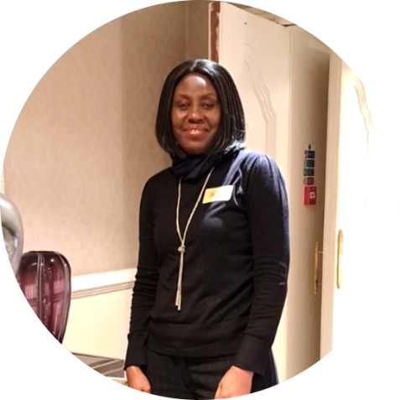
TEAM RECRUITMENT
No.1
BELOW EVP
1ST PLACE
SELAH KAMUWANGA ROMAIN
Group Leader | EVP: Steve Jenkins
45 RECRUITS
2ND QUARTER 2024
HOW TO BUILD A SUPER HIERARCHY 2024

Slide 89
TEAM PREMIUM
2ND QUARTER 2024
HOW TO BUILD A SUPER HIERARCHY 2024

Slide 90
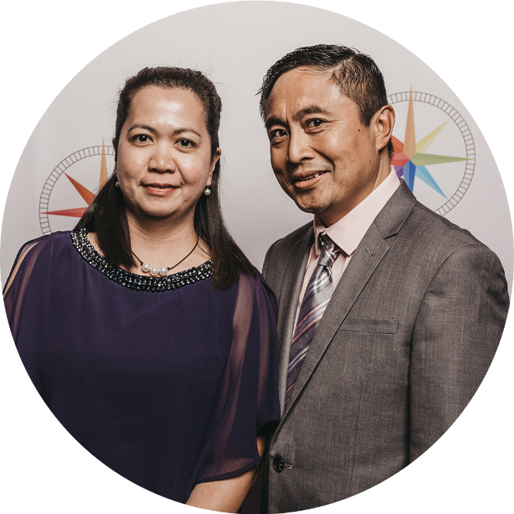
TEAM PREMIUM
No.1
EVP AND ABOVE
1ST PLACE
DOLLY & WILLIAM BRIGHT
£68,291
2ND QUARTER 2024
HOW TO BUILD A SUPER HIERARCHY 2024

Slide 91
TEAM PREMIUM
No.1
BELOW EVP
1ST PLACE
ROSE OKECHI-MBALASO
Group Leader | EVP: Bevin Wint
£29,327
2ND QUARTER 2024
HOW TO BUILD A SUPER HIERARCHY 2024

Slide 92
TEAM BALANCED BUILDER
2ND QUARTER 2024
Recruiting
Clients

Slide 93
TEAM BALANCED BUILDER
No.1
EVP AND ABOVE
1ST PLACE
DOLLY & WILLIAM BRIGHT
1,822,519 POINTS
2ND QUARTER 2024
HOW TO BUILD A SUPER HIERARCHY 2024

Slide 94
TEAM BALANCED BUILDER
No.1
BELOW EVP
1ST PLACE
SELAH KAMUWANGA ROMAIN
Group Leader | EVP: Steve Jenkins
925,060 POINTS
2ND QUARTER 2024
HOW TO BUILD A SUPER HIERARCHY 2024

Slide 95
PERSONAL RECRUITMENT
2ND QUARTER 2024
HOW TO BUILD A SUPER HIERARCHY 2024

Slide 96
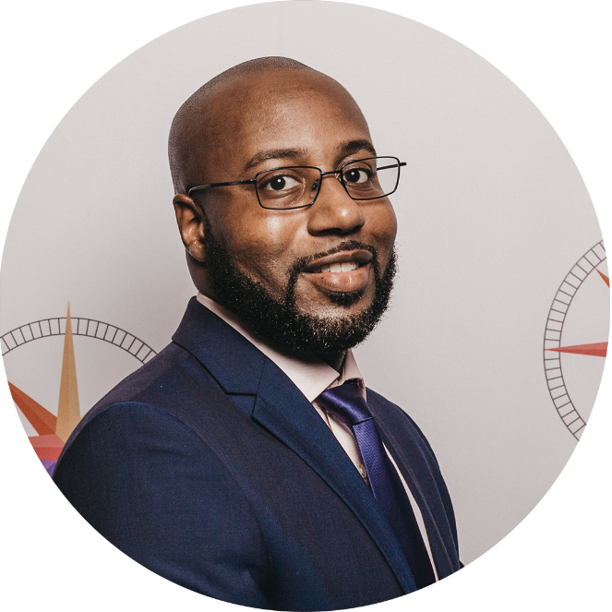
PERSONAL RECRUITMENT
No.1
EVP AND ABOVE
1ST PLACE
DARYL HARPER
14 RECRUITS
2ND QUARTER 2024
HOW TO BUILD A SUPER HIERARCHY 2024

Slide 97
PERSONAL RECRUITMENT
No.1
BELOW EVP
1ST PLACE
KRISTINE TANYAG
EVELYN CUNANAN
Group Leader | EVP: Dolly & William Bright
Group Leader | EVP: Dolly & William Bright
8 RECRUITS
8 RECRUITS
2ND QUARTER 2024
HOW TO BUILD A SUPER HIERARCHY 2024

Slide 98
PERSONAL PREMIUM
2ND QUARTER 2024
HOW TO BUILD A SUPER HIERARCHY 2024

Slide 99
PERSONAL PREMIUM
No.1
EVP AND ABOVE
1ST PLACE
BARBARA ANDERSON-STEWART & LINTON STEWART
£23,420
2ND QUARTER 2024
HOW TO BUILD A SUPER HIERARCHY 2024

Slide 100
PERSONAL PREMIUM
No.1
BELOW EVP
1ST PLACE
ROSE OKECHI-MBALASO
Group Leader | EVP: Bevin Wint
£9,543
2ND QUARTER 2024
HOW TO BUILD A SUPER HIERARCHY 2024

Slide 101
PERSONAL BALANCED BUILDER
2ND QUARTER 2024
Recruiting
Clients

Slide 102
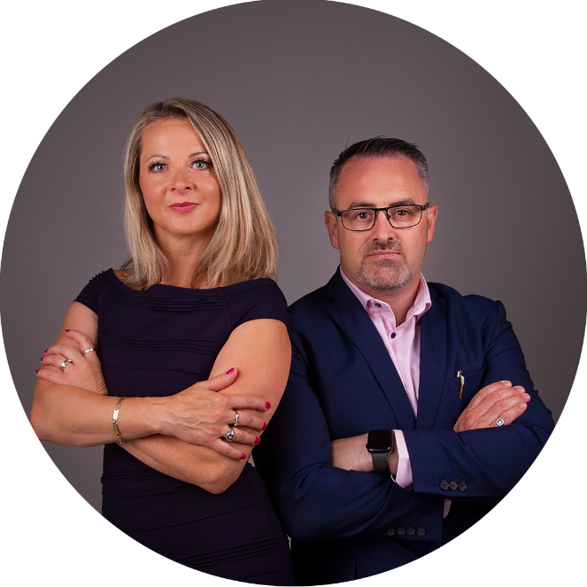
PERSONAL BALANCED BUILDER
No.1
EVP AND ABOVE
1ST PLACE
ALAN & ANDREA PALMER
131,846 POINTS
2ND QUARTER 2024
HOW TO BUILD A SUPER HIERARCHY 2024

Slide 103
PERSONAL BALANCED BUILDER
No.1
BELOW EVP
1ST PLACE
EVELYN CUNANAN
Group Leader | EVP: Dolly & William Bright
61,651 POINTS
2ND QUARTER 2024
HOW TO BUILD A SUPER HIERARCHY 2024

Slide 104
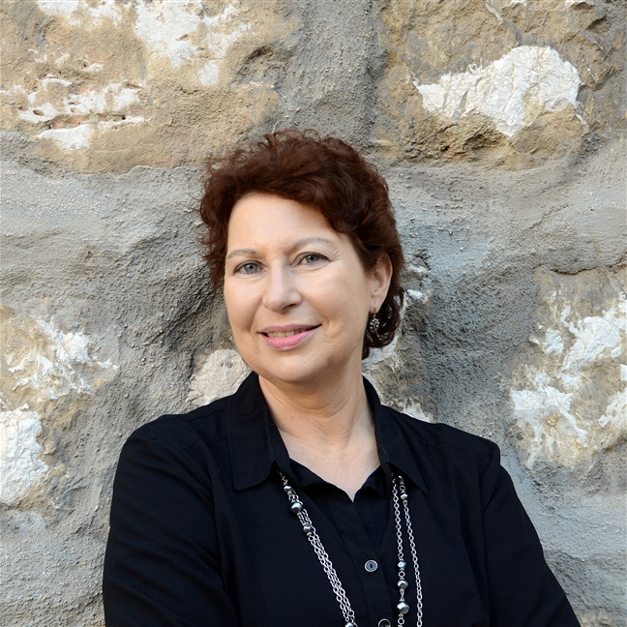
2ND QUARTER update from media team
Margo lestz
Media & Comms Manager, FSC
HOW TO BUILD A SUPER HIERARCHY 2024

Slide 105
MONEY MATTERS
Your Genistar Quarterly Newsletter
Summer Edition
Out Now
Financial Literacy
Financial Literacy
Quiz
Summer Sun and
Financial Fun
Financial Education
for Children
New Podcast, Episode 1 Financial Literacy
HOW TO BUILD A SUPER HIERARCHY 2024

Slide 106
FINANCIAL FREEDOM FOR ALL
Our New Genistar Podcast
2 Episodes
Out Now
On YouTube
Episode 1
FINANCIAL LITERACY
Jeff Lestz & Steve Jenkins
Episode 2
HOW TO MAKE AI YOUR CO-PILOT
Jeff Lestz & Dan Debnam
HOW TO BUILD A SUPER HIERARCHY 2024

Slide 107
SOCIAL MEDIA
FOLLOW us – LIKE us – SHARE our posts
Instagram
TikTok
Facebook
@genistarlimited
@genistarofficial
@Genistar
X (Twitter)
LinkedIn
YouTube
@Genistar
@Genistar
@genistarlimited
HOW TO BUILD A SUPER HIERARCHY 2024

Slide 108
Would you like to feature in
Genistar’s social media?
Send us your videos
Portrait orientation – Hold your phone vertically
Keep it short - Videos should be under 1 minute – maximum of 2 minutes
Keep it generic - We will only use generic content – no mention of dates or claims of how much one can earn
Not everything is about business - We also appreciate personal development tips, life lessons, etc.
Send us your videos – Send videos to comms@genistar.net
Questions? If you have any questions, just ask – we are happy to help
HOW TO BUILD A SUPER HIERARCHY 2024

Slide 109
NEW
INTRODUCTION VIDEO Helping You Achieve Your Dreams
Ten-minute video
Can be used to replace the old 20-minute BOM video
Will be used in Lead Funnel system
Can be sent directly to prospects
Will be updated soon
Scan the QR code and view the video
HOW TO BUILD A SUPER HIERARCHY 2024

Slide 110
HOW TO BUILD A SUPER HIERARCHY 2024

Slide 111
CRM Customer Relationship Management System Updates
Salwan al-zyadi
HOW TO BUILD A SUPER HIERARCHY 2024

Slide 112
CRM Customer Relationship Management System Updates
Latest improvements to the system

Slide 113
New Video: ‘Helping You Achieve Your Dreams’
We cut down the 24-minute video and created a new and exciting
10-minute video and added more value to the viewers.
This will be part of the funnel and we expect it to optimise the conversion rates and insure people understand the business and concepts.
Thanks to the Media Team!

Slide 114
Bulk CSV uploads
Now you can populate your old referral card onto a sheet and upload them all in one go!
A perfect solution for those who have been in the business for a long time and want to leverage and automate this process.
GDPR consent email to be sent followed by an introduction by you.

Slide 115
Tutorial videos
Tutorial video has been added to each section of the system to help you off to a great start and get familiar with the functions.

Slide 116
Qualify your leads
Your leads will now qualify themselves based on the 5-star system when they go through the funnels.
You also have the option to manually qualify them.

Slide 117
Action centre
An action centre has been added to help you stay organised.
One click calls
Send meeting invites
Send ‘Tried to Call’ emails and SMS
Status overview
Filtering by star rating
Reminders
Notes

Slide 118
August 9th
Save the date for the release!
All EVP’s and above.

Slide 119
Future updates
Functions and feature to look forward to
Hierarchy management
Leads distribution
Campaign builder
Live Ai assessor on calls

Slide 120
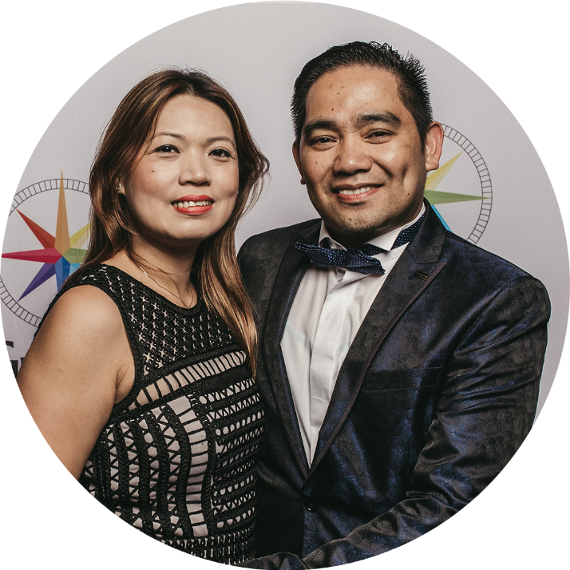
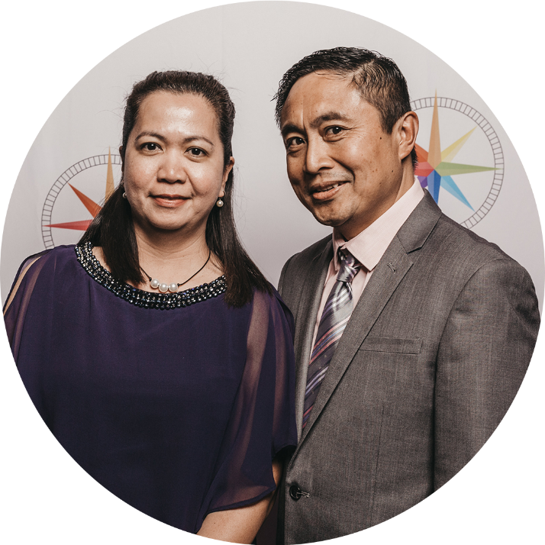
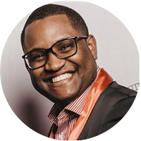
PANEL DISCUSSION WITH STEERING COMMITTEE
Jeff Lestz
Arvin & Genevieve Burgos
Alan & Andrea Palmer
Barbara Anderson-Stewart &
Linton Stewart
Steve Jenkins
Dolly & William Bright
Bevin Wint
HOW TO BUILD A SUPER HIERARCHY 2024

Slide 121
News & announcements

Slide 122
Iba fee extended!
£99 IBA FEE EXTENDED TO JULY MONTH END
IBA FEE - £140 = £99
PROMO CODE: 99GSTAR
MILLIONAIRE UNIVERSITY 2024

Slide 123
Holiday in the sun
ANYONE CAN QUALIFY
HOW TO BUILD A SUPER HIERARCHY 2024

Slide 124
Holiday in the sun open to all...
ANYBODY WHO DOES...
10 x 10 for 3 months
OR
30 x 30 cumulative in 3 out of 4 months
(including your entire team’s business)
APRIL, MAY, JUNE & JULY
ALL normal competition rules will apply such as:
No more than 50% from one leg will count
No more than £1,000 APE will count per policy
Above 90% persistency including CFI
Refunded IBAs will be deducted from total
The award is non-transferable, you cannot give it to someone else
All business needs to be activated
HOW TO BUILD A SUPER HIERARCHY 2024

Slide 125
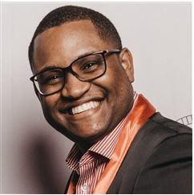
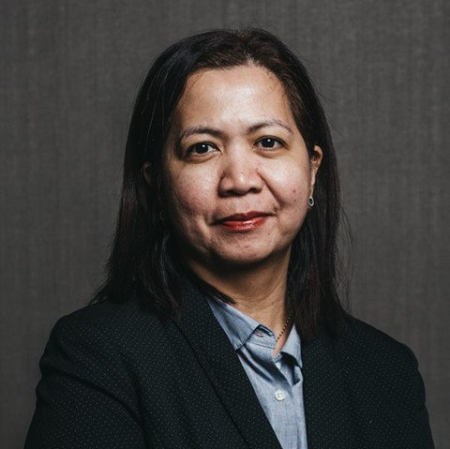
Holiday in the sun Anyone can qualify
QUALIFIED LEADERS
Bevin Wint
SVP
Dolly & William Bright
SVP
Joyce Agbor
EVP
Steve Jenkins
SNSD
HOW TO BUILD A SUPER HIERARCHY 2024

Slide 126
Holiday in the sun EVP AND ABOVE
WHAT YOU NEED TO ACHIEVE IN JULY TO WIN!
Name | Team Recruits Left | Premium Left
Alan & Andrea Palmer | 2 | £4,360
Arvin & Genevieve Burgos | 6 | Achieved
Barbara Anderson-Stewart | 10.25 | Achieved
Christiane Metoukson Dawe | 4.5 | £12,383
Justina & Christopher Ilochi | Achieved | £12,392
Olayinka Cline-Thomas | 13 | £21,229
Roger Munar | 21.75 | Achieved
Roger & Leilani Palima | 10.5 | £10,464
Sam & Gilda Leigh | Achieved | £13,067
Sharon Wint-Gordon | 10 | £16,812
HOW TO BUILD A SUPER HIERARCHY 2024

Slide 127
Holiday in the sun BELOW EVP
WHAT YOU NEED TO ACHIEVE IN JULY TO WIN!
Name | Team Recruits Left | Premium Left
Evelyn Cunanan (GL) | 9 | £5,678
Rose Okechi-Mbalaso (GL) | 1 | £10,178
Selah Kamuwanga Romain (SGL) | Achieved | £10,151
HOW TO BUILD A SUPER HIERARCHY 2024

Slide 128
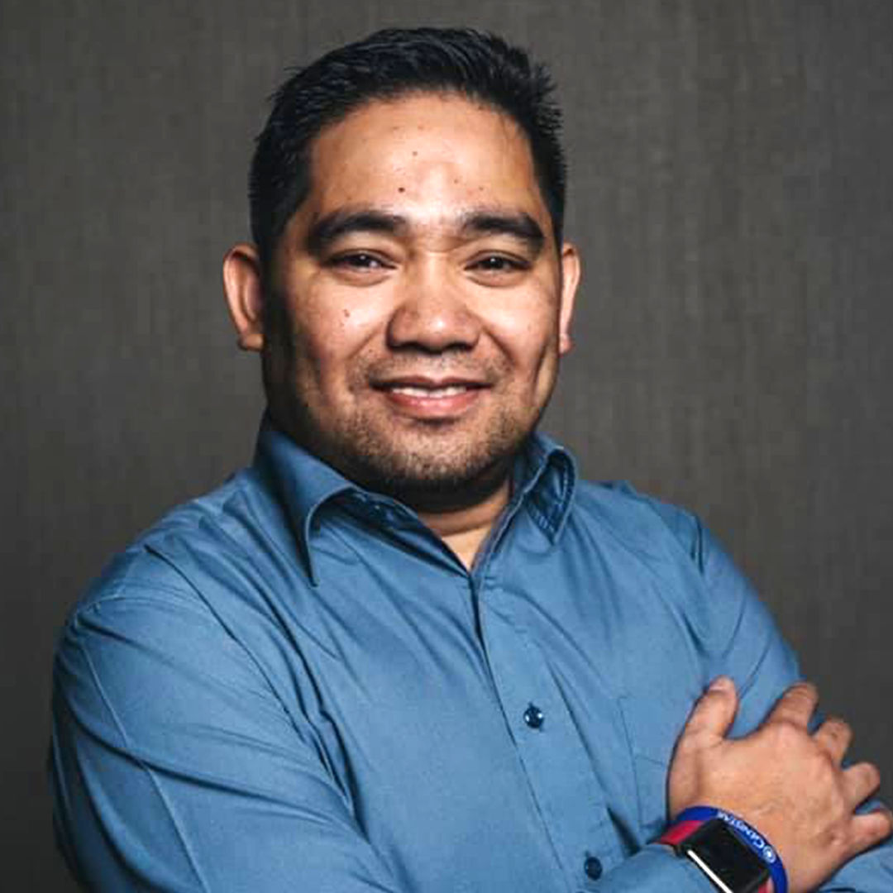
ONLINE BUSINESS OVERVIEW MEETING EVERY MONDAY
(except when there’s a live BOM)
Hosted by: Steve, Arvin & Alan
Topic: Genistar Business Overview
Time: 7:30pm (Join at 7:15pm for a 7:30pm start)
Meeting ID: 825 340 665
Scan and save the link
HOW TO BUILD A SUPER HIERARCHY 2024

Slide 129
LIVE BUSINESS OVERVIEW MEETING MONDAY 22ND JULY 2024
LONDON
Doubletree Hilton Kensington, 100 Cromwell Rd, London, SW7 4ER
SHEFFIELD
The Hope Centre, Bernard Road, S2 5BQ
LEEDS
Locked In Games, 2 Chapeltown Road, Leeds, LS7 3AP
BIRMINGHAM
Midlands Arts Centre, Canon Hill Park, Birmingham, B12 9QH
MANCHESTER
AC Hotel Manchester, 17-19 Trafford Road, Salford Quays, Manchester, M5 3AW
Scan to view details and register
HOW TO BUILD A SUPER HIERARCHY 2024

Slide 130
COMPANYWIDE ORIENTATION
DATE: EVERY TUESDAY
TIME: 8:00 PM
Zoom Meeting details:
Meeting ID: 845 3065 5901
Passcode: 737044
Hosted by
Genistar EVPs
Scan to join!
HOW TO BUILD A SUPER HIERARCHY 2024

Slide 131
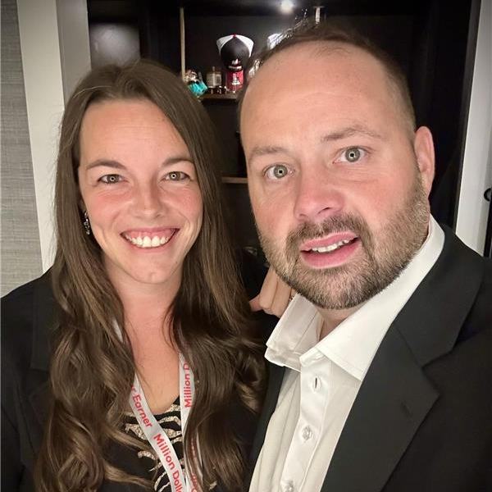
SUNDAY CALL WITH ANDY & BRITTaNY onstead
National Sales Director, Primerica
Holds Primerica record for reaching $1M income fastest (5 years)
Holds Primerica record for top recruiting baseshop – 702 recruits in one month
Holds Primerica record for top premium in baseshop – $530,000 in one month
Holds Primerica record for 12 month recruiting – 4,860 in one year
DATE: 21st July 2024, Sunday
TIME: 10pm
Hosted by: Steve Jenkins
Scan and save the link!
HOW TO BUILD A SUPER HIERARCHY 2024

Slide 132
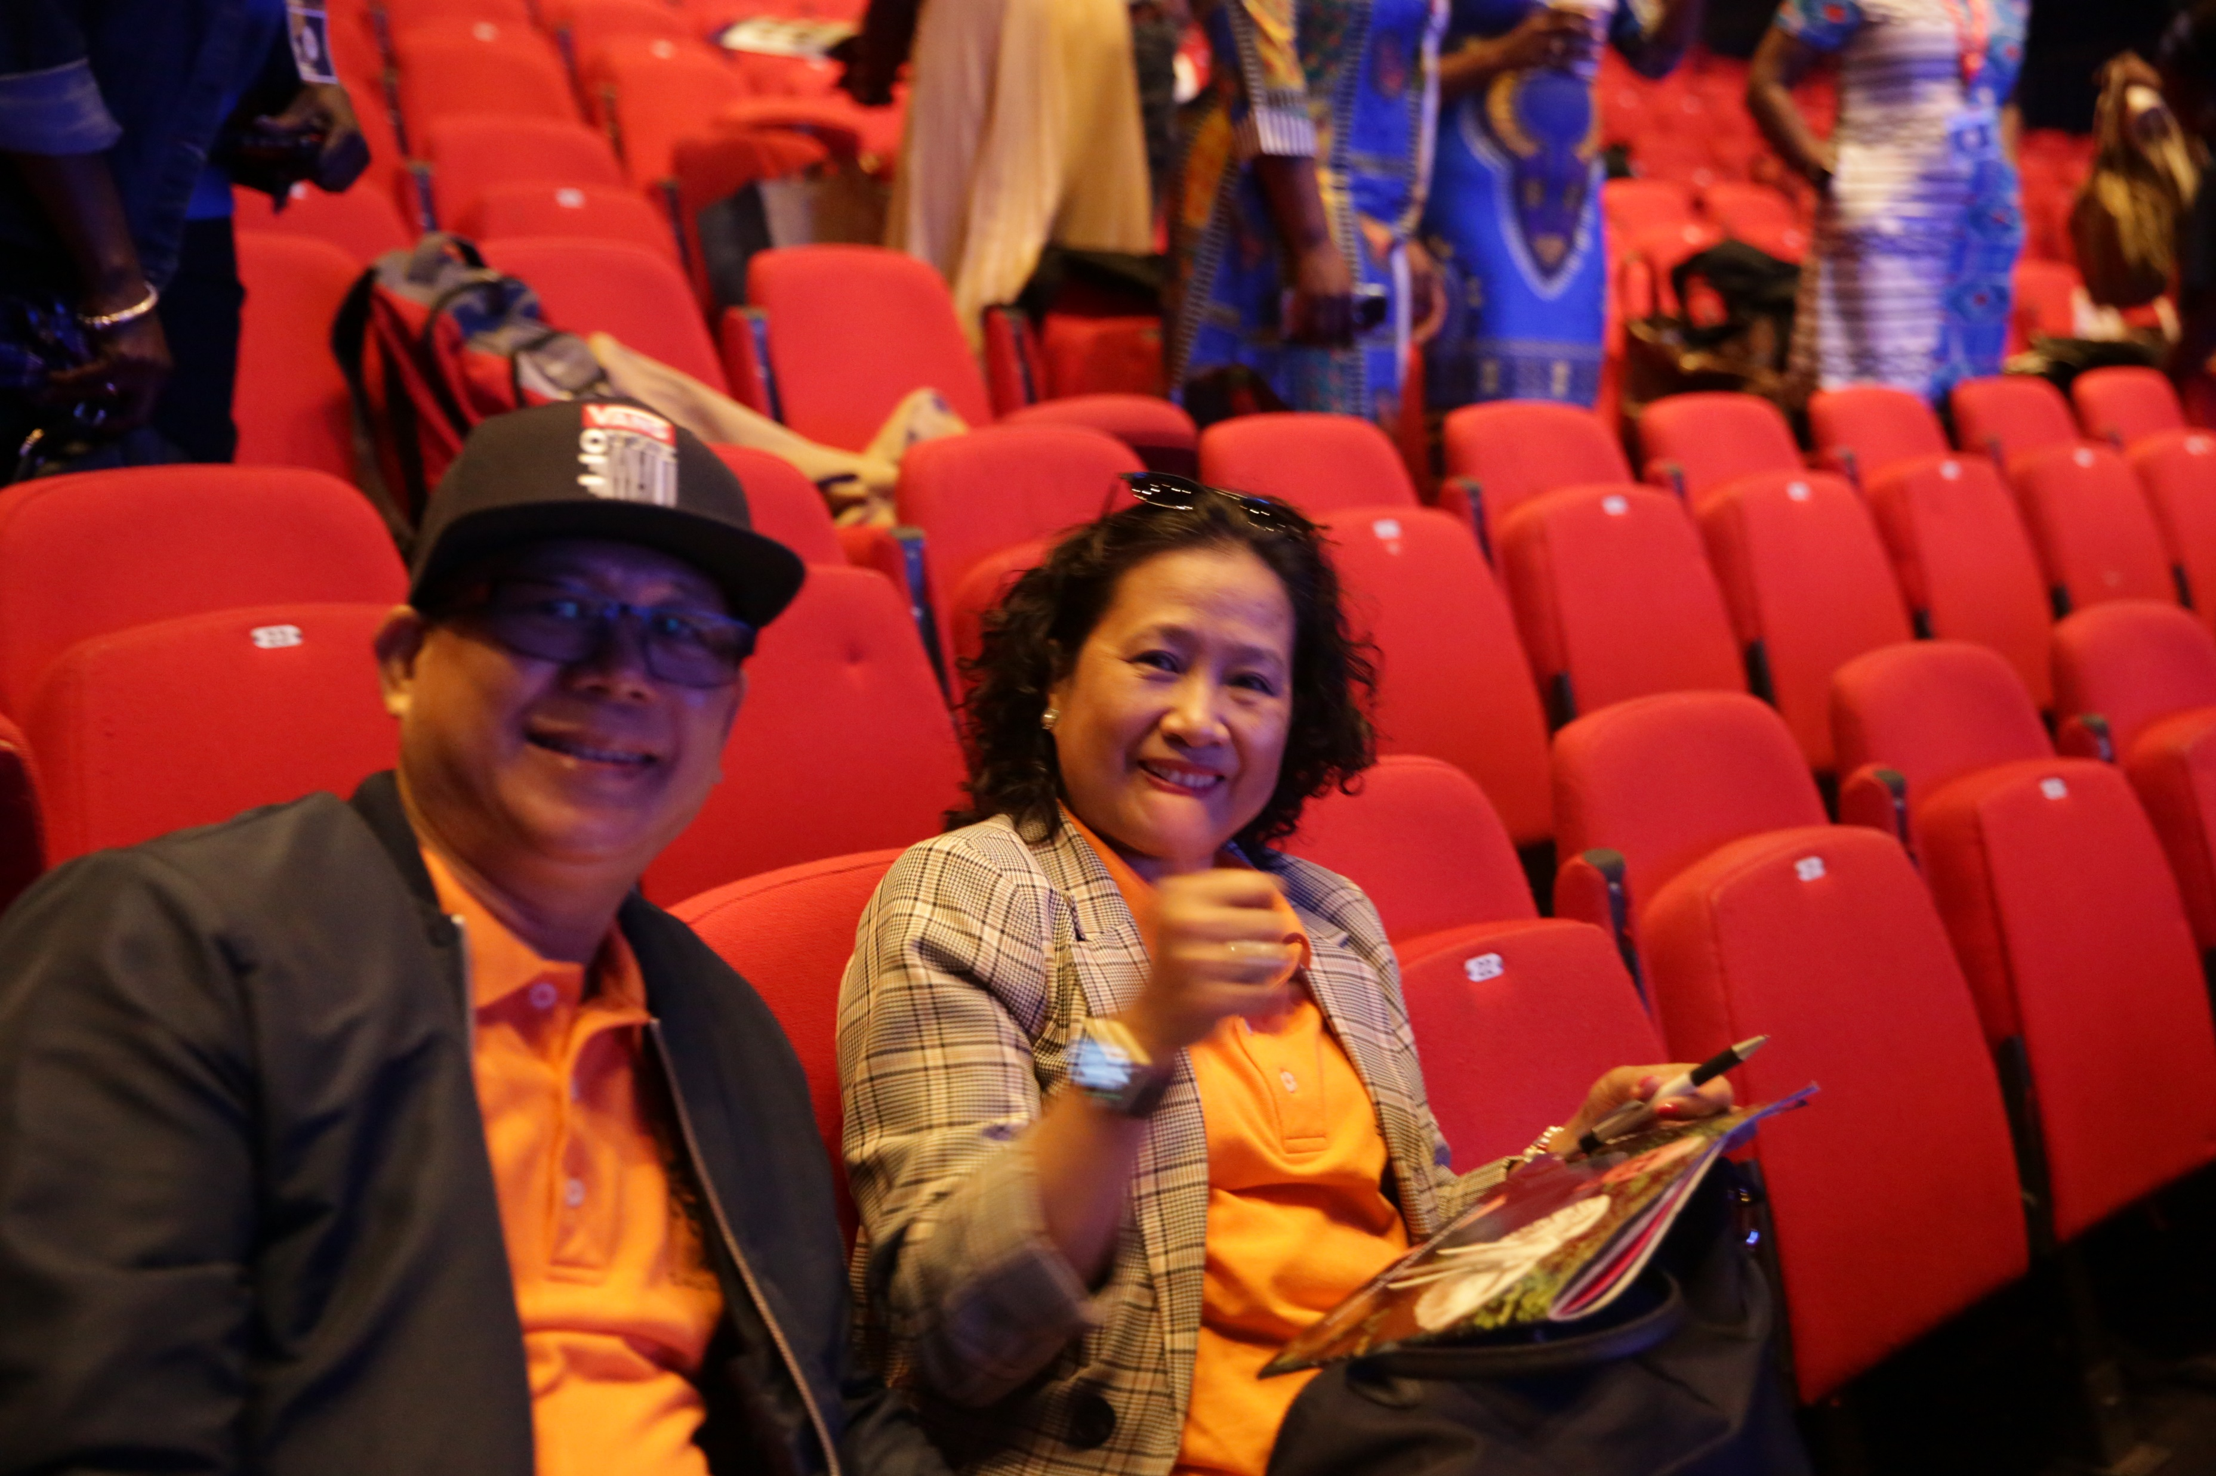
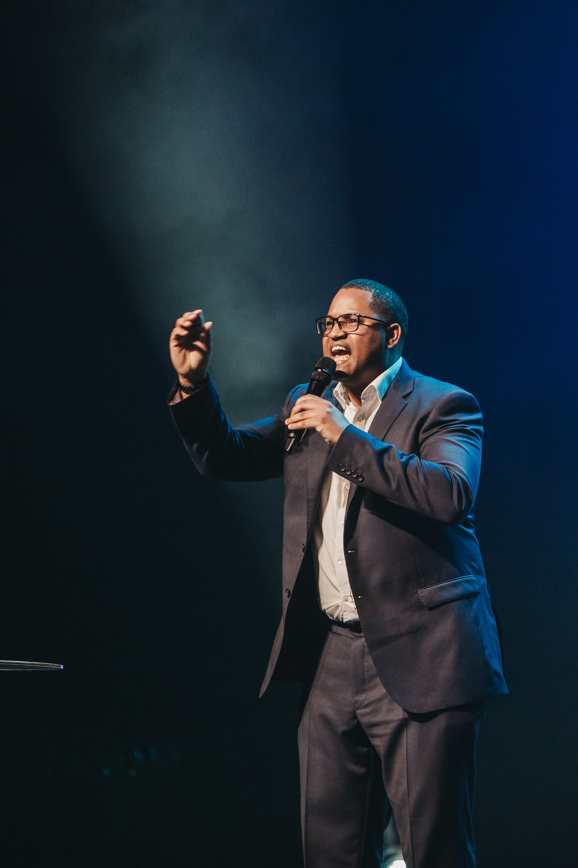
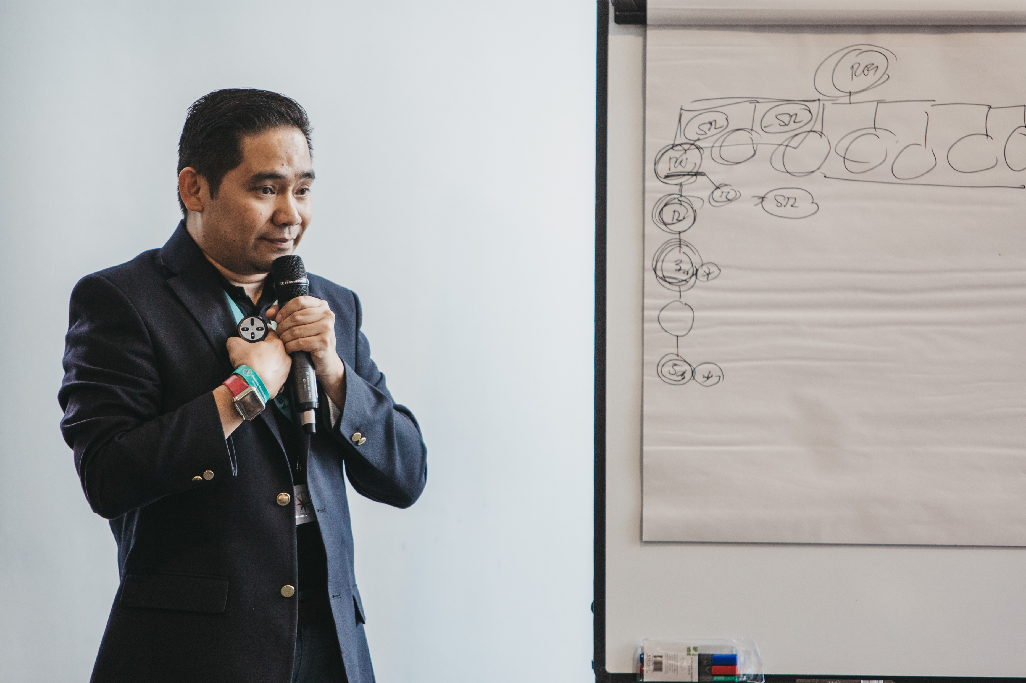
SAVE THE DATE!
18TH OCTOBER 2024 – EVP DAY​
19TH OCTOBER 2024 – BOOTCAMP
Scan and register now!
HOW TO BUILD A SUPER HIERARCHY 2024

Slide 133
SAVE THE DATE!
GENISTAR CONVENTION
14th & 15th February 2025​
Special Guests from Primerica
Andy & Brittany Onstead
& SO MUCH MORE TO BE ANNOUNCED
HOW TO BUILD A SUPER HIERARCHY 2024

Slide 134
WRAP UP
JEFF LESTZ, CEO
HOW TO BUILD A SUPER HIERARCHY 2024

