Slide 3
About Us

Slide 4
We Are Authorised And Regulated

Slide 5
Problems Facing Families Today
Debt
Debt can be an obstacle that prevents people from achieving their goals and dreams.
Wills & Trusts
70% of families do not have a will or their assets in trust, leaving potential problems in the event of death.
Protection
Are all protection policies the same? Most people don’t know what sort of protection is right for them or how to work out how much they need.
Retirement
Will you be one of the 95% ?
F1040-06/24

Slide 6
Genistar Is Expanding Rapidly

Slide 8
Problems Facing Families Today Where Will You Be At Retirement?

Slide 9
How Would You Like To Retire?

Slide 10
Problems Facing Families Today Let's Talk Debt Freedom

Slide 11
Do You Know How The Banks Make Money?
Number of Years | 3%* | 6%* | 12%*
0 | £10,000 | £10,000 | £10,000
6 |  |  | £20,000
12 |  | £20,000 | £40,000
18 |  |  | £80,000
24 | £20,000 | £40,000 | £160,000
30 |  |  | £320,000
36 |  | £80,000 | £640,000
42 |  |  | £1,280,000
48 | £40,000 | £160,000 | £2,560,000
The Rule of 72 approximates the number of years it will take to double your money at a fixed rate of interest.
To calculate it, you divide 72 by the rate of return that your investment earns.
Doesn't it make sense to get the Rule of 72 working FOR you rather than AGAINST you?
Do you think people need to know this?
F1040-06/24
*PLEASE NOTE: these rates are for illustrative purposes only.
Notes:
Animation Notes - £2,560,000 in red

Slide 14
Homeowners How to Pay Less

Slide 17
12 Normal Monthly Mortgage Payments

Slide 18
26 Fortnightly Mortgage Payments

Slide 19
Fortnightly Mortgage Payments

Slide 20
Problems Facing Families Today Protection Needs

Slide 21
In Your Lifetime You Could Earn A Fortune

Slide 22
What Is Your Family’s Biggest Asset?

Slide 24
Why Take Out Protection?

Slide 25
Is All Life Cover The Same?

Slide 26
Problems Facing Families Today Will Planning

Slide 27
Do You Know How The Banks Make Money?

Slide 28
So Why Should You Invest?

Slide 29
Become an Owner, Not a Loaner
Bypass the Middleman

Slide 30
Big Events are Not Uncommon through History

Slide 31
Most People Don’t Plan To Fail They Fail To Plan

Slide 32
Overall Solution Financial Game Plan

Slide 33
Our Commitment To You

Slide 34
3 Income Opportunities with Genistar

Slide 36
Regulatory Disclaimer

Slide 37
Thank you…

Slide 40
Would You Be Willing To Invest Some Time In Order To:

Slide 41
Getting The Right Insurance Policy

Slide 42
Other Policy Options To Consider:

Slide 43
Serious vs Critical Illness Cover

Slide 44
Private Medical Insurance (PMI)

Slide 45
Income Protection Insurance

Slide 48
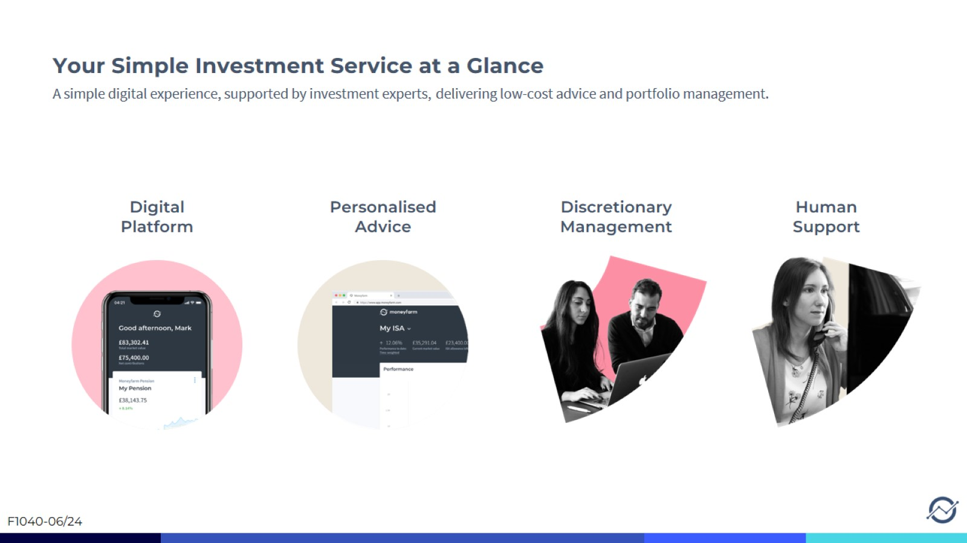
Your Simple Investment Service at a Glance

Slide 49
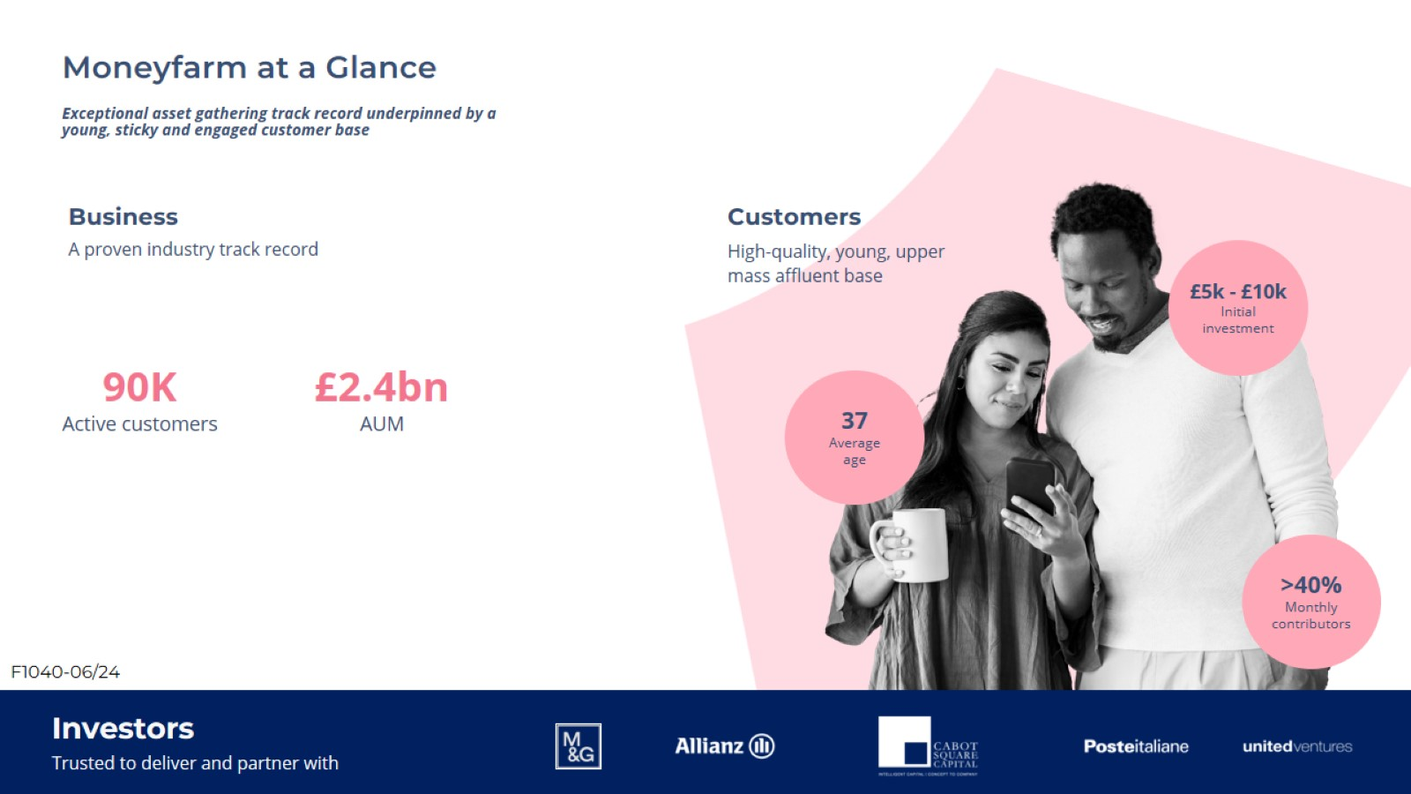
Exceptional asset gathering track record underpinned by a young, sticky and engaged customer base

