Slide 1
IBA Applications:
How to get yours approved faster!

Slide 2
Introduction
QUICKER IBA APPROVALS
This presentation aims to help you get your IBAs approved quicker and more efficiently.
With both the Field and the FSC’s best interests in mind, and to uphold the integrity of the services Genistar Ltd provides to clients, the following slides will address areas commonly picked up during the IBA submission process – As a team, let’s work together towards a reduction in pending applications and Fresh Desk tickets raised!
I B A

Slide 3
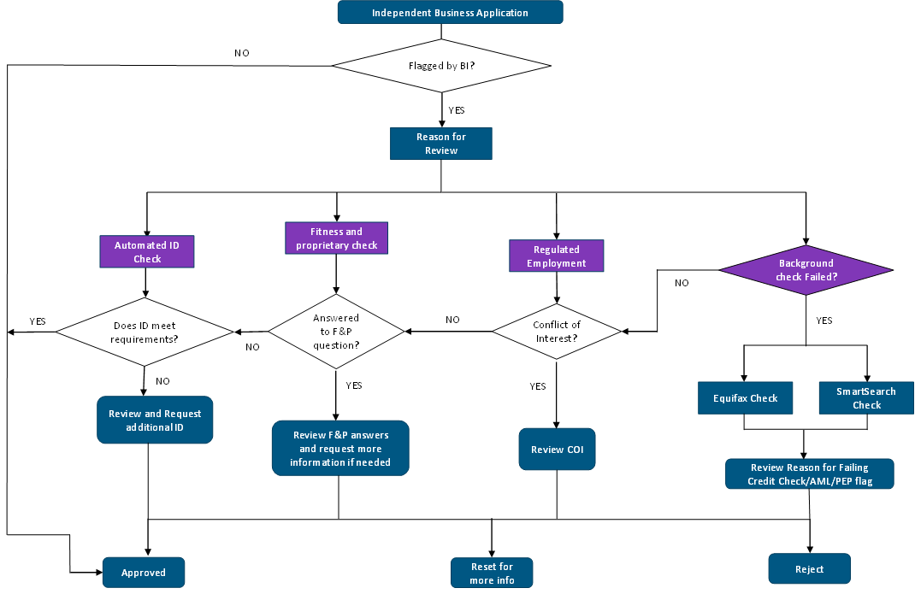
Overview
For context, the below details the process which Compliance follows during the IBA submission process.
Flagged by Compliance?
Answer to F&P question?

Slide 4
How to Get Your IBA Approved Faster
As a team at Genistar, our primary objective is to service our clients and to assist them throughout their financial journeys.
First impressions count! We all want to strive for efficiency throughout our various business functions; the application process is no exception.
Considering this, and to uplift the overall IBA submissions process, the following slides show some common issues picked up by Compliance that slow down IBAs.
Please familiarise yourself with the information detailed in the following slides.
I HAVE AN IDEA!

Slide 5
Recruit Information Sign Up Process
Name Spelling – Make sure you use the person’s legal name when you sign them up for an IBA. If your recruit has a preferred name, please use the toggle to enter that name under the preferred name section. We cannot approve applications if we do not have their legal name as indicated on their ID documentation. Please also double check spelling is correct.
Date of birth – Please ensure this is correct and matches the date of birth on their ID document.
Address – If your recruit lives at 14 B, please ensure you state 14 B and not just number 14.

Slide 6
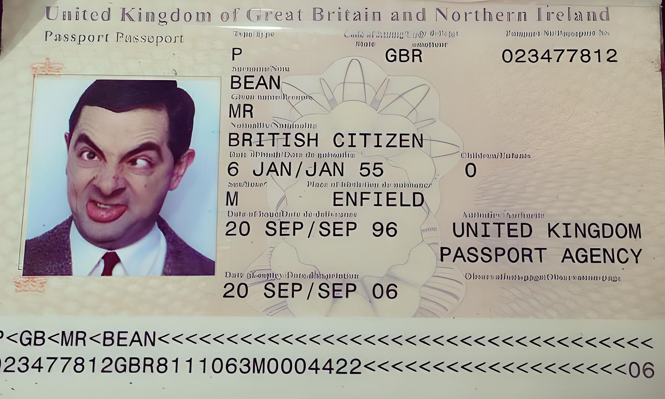
ID Documentation and Right to Work
For all ID documentation such as passports, drivers licence, residency documents, visas etc. - please ensure the whole document is clearly visible (i.e.. No blurred images, no fingers covering areas of the ID document). ID’s that are blurred or have sections covered or that cannot be easily read will be rejected as we must be able to read all the details to process the IBA.
Please ensure the expiry dates listed on Genistar Online for the recruit match the expiry date stated on the ID document – ID’s showing mis-matched dates will be rejected.
Please do your best to ensure the ID document is valid and current to avoid any potential hold ups in the application process.
Additional documentation may be requested to verify a recruit’s full name or address if the applicant has been flagged for additional screening via SmartSearch (i.e.. utility bill, bank statement, tenancy agreement.)

Slide 7
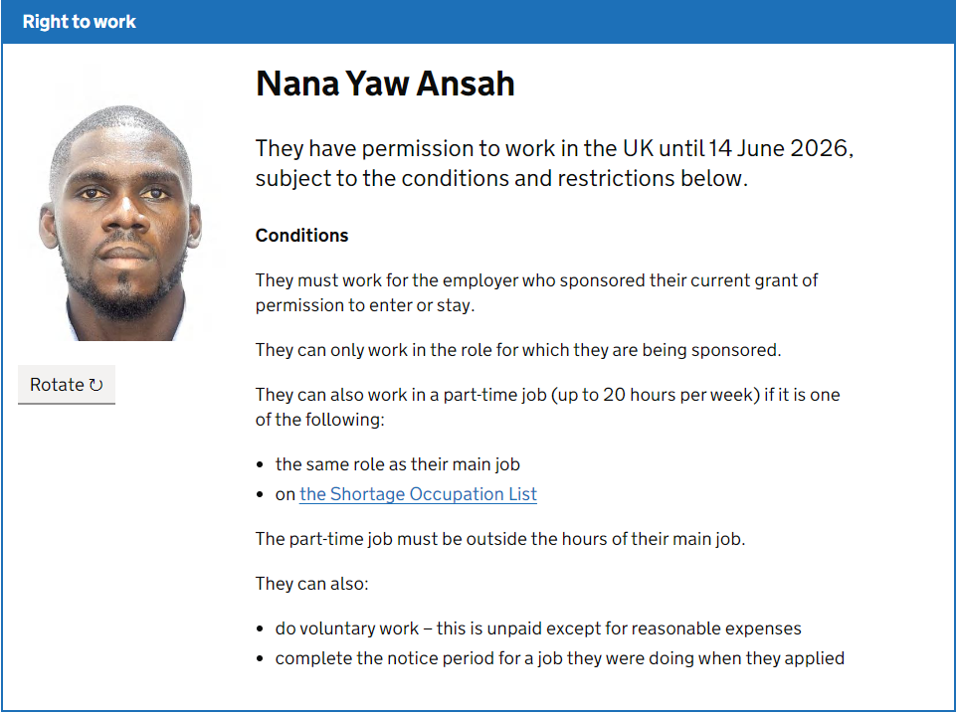
When is a Sharecode Required?
A sharecode is required for ALL applicants that do not hold a valid British Passport. This is enforced by the UK Government to verify the applicants right to work in the UK.
A right to work sharecode must start with a W to be valid and consist of 9 characters.
There are several exemptions that apply under Sections 8 (2), 8 (3) and 8 (4) of the Immigration Act 1971 which may apply to one of your recruits. For further guidance - Prove your right to work to an employer: Get a share code online - GOV.UK (www.gov.uk)
Mr. Smith

Slide 8
A Sharecode is Not Required Should Your Recruit Meet One of the Below Criteria:
A full-time member of HM Forces;
A Reservist with HM Forces deployed or due to be deployed;
Persons who are serving or posted for service in the UK as a member of a visiting force;
The law defining whether someone is a member of HM Forces is set out in the Armed Forces Act 2006. To be a member of HM Forces they need to be a member of the Royal Navy (including Royal Marines), British Army (including Brigade of Gurkhas) or Royal Air Force. All members of HM Forces must have enlisted in the UK; and
Any person who is exempt from immigration control does not require prior entry clearance.
Please note you will be required to provide Compliance with evidence should your recruit meet the above criteria.

Slide 9
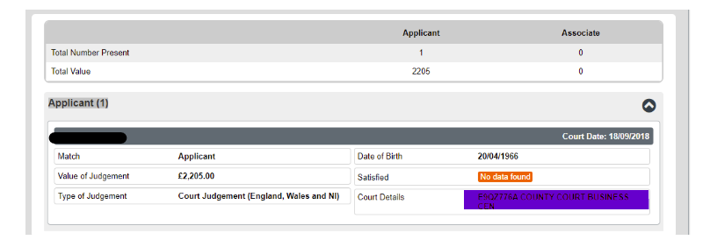
Guidance Surrounding CCJs and Insolvencies
If Equifax (the Compliance screening service) has flagged an applicant for having a potential outstanding County Court Judgment (CCJ) or a potential insolvency matter, additional documentation may be required to provide evidence of payment/satisfaction at the time of the application.
If your recruit tells you they have a CCJ at the point of application, make them aware that further information will be requested from them so they can locate the relevant paperwork in preparation.
For further clarification surrounding thresholds pertaining to CCJs and insolvencies which may impact the progress of an application, please refer to the following – IBA – Fitness for Debt and Bankruptcy.

Slide 10
Thank you for reading!
Should you have any questions regarding the IBA submissions process please do not hesitate to contact a member of Compliance.

