Slide 9
MAIN PAIN POINTS

Slide 10
WHOA!

Slide 11
01

Slide 12
FUNNELS

Slide 13
PERSONAL
LANDING PAGES

Slide 14
VIDEO FUNNELS TAILORED TO EACH INTEREST

Slide 15
YOUR DASHBOARD

Slide 16
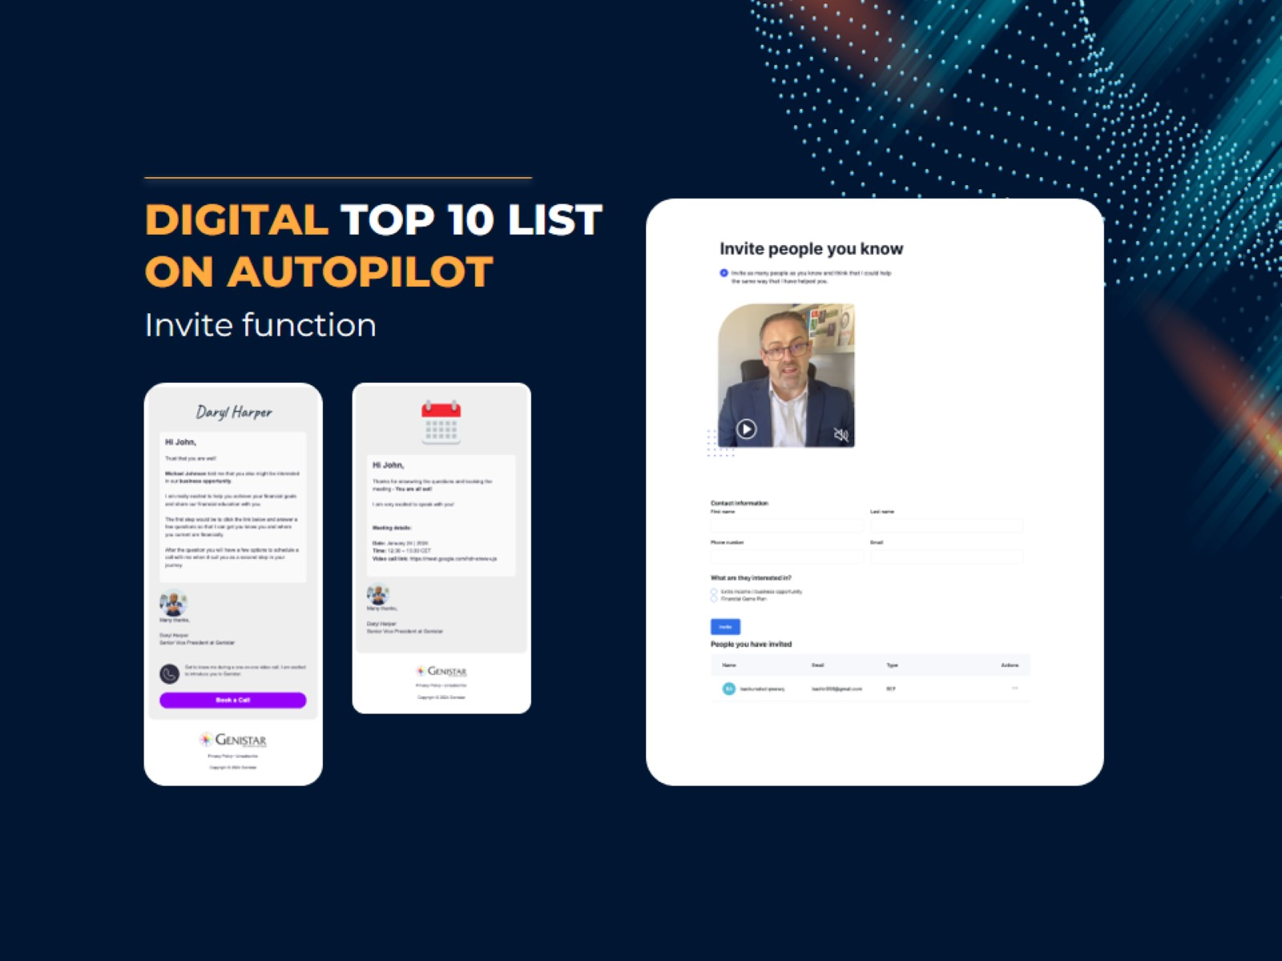
DIGITAL TOP 10 LIST
ON AUTOPILOT

Slide 17
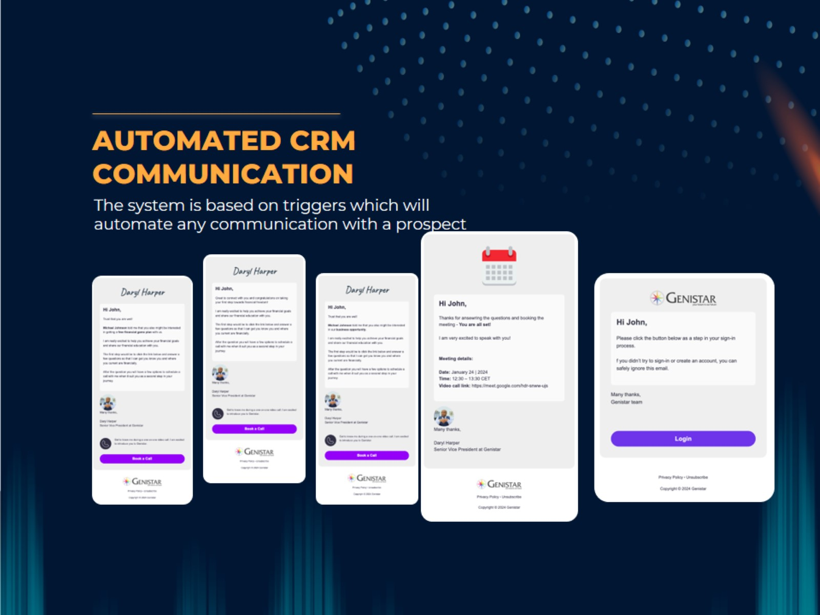
AUTOMATED CRM COMMUNICATION

Slide 18
SEAMLESS INTEGRATION WITH GENISTAR ONLINE

Slide 19
ALL YOUR (& YOUR TEAM’S)
METRICS IN ONE PLACE

Slide 20
LIVE PREVIEW

Slide 21
INVITE EMAIL

Slide 22
Sign up Today!

